Slide 1
Reducing Risk and Building Maintainable Systems with Encapsulation
Ed Mullen | @edmullen

Slide 2
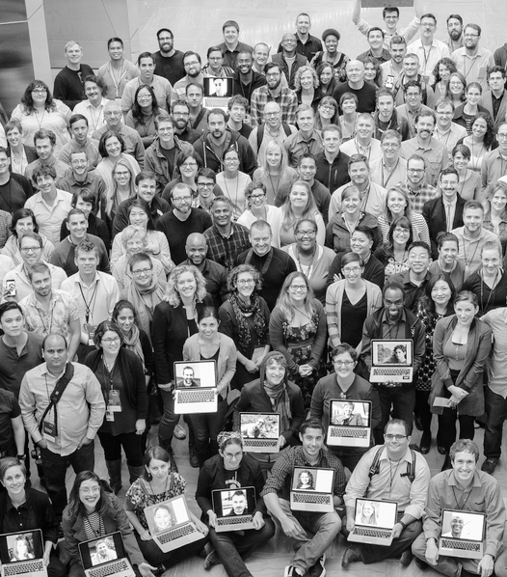

We’re government employees that can help you build, buy, and share the best digital government services available.
Hi.
Ed Mullen
18F Strategist
Notes:
Hi, I’m Ed Mullen
I’m a strategist at 18F
18F is a tech consultancy within GSA
Fed
We do
We work with federal and state agencies
This is our team
That’s me in the back
I’m always in the back of photos
I’ve worked with
CMS, FNS, ACF
several states on projects in the health and human services space
Prior to 18F I worked at HHS for a while
Lead user experience for HealthCare.gov in 2010 and again in 2012/13

Slide 3
We want to help people get the benefits they deserve.
Notes:
We work in this field because
we want to help people get the benefits they deserve
and are entitled to.

Slide 4
We rely on technical systems to do this.
Notes:
We rely on a variety of technical systems to ensure
eligible people get enrolled
benefits are issued
providers get paid for the care they provide.
Program success is dependent on the efficacy of the underlying technical infrastructure.

Slide 5
We want these systems to work well.
Notes:
Compliance is not the goal.
We want these systems to work well.
We’ve seen the impact these programs can have.
We know they save lives.
Maybe we were once enrolled in these programs, or members of our families.

Slide 6
But none of these systems are perfect.
Notes:
But none of these systems are perfect.
If we’re honest, many are really struggling
Everyone has either outdated legacy systems
or expensive newer systems we barely understand
Few can quickly deploy new functionality or tools.

Slide 7
Modernizing these systems is hard.
Notes:
Improvement efforts are often problematic
I don’t need to tell you all, or give examples

Slide 8
13% of major government software projects succeed.
The Standish Group

Slide 9
Why?
Waterfall development methods
Very large projects
Up-front requirements gathering
Diminished technical capacity within government
Long, high-dollar vendor contracts
Notes:
There are many reasons
Some include READ

Slide 10

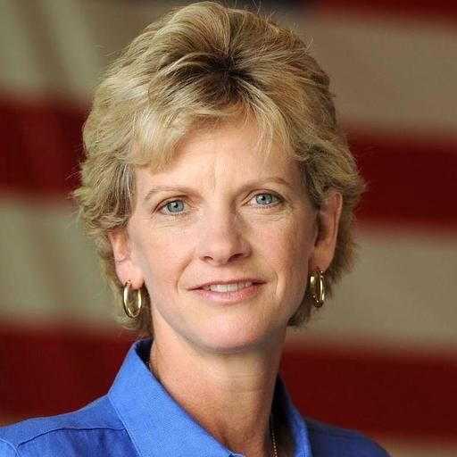
Our new report speaks to these issues.
Robin Carnahan
Notes:
We recently released a new report on how to avoid these problems.
One of the authors is here
It can help you set projects up for success by
asking the right questions,
identifying the right outcomes,

Slide 11
Basic principles of modern software design
User-centered design
Product ownership
Agile software development
DevOps
Modular contracting
Building with loosely-coupled parts
Notes:
The report details the basic principles of modern software design.
User-centered design - Ongoing research with users and prioritizing around their needs
Product - Understanding where you’re headed, balancing user and business needs, course correcting as needed
Agile - Developing working software delivered in short cycles, always re-evaluating as you go
DevOps - Sometimes DevSecOps - Powering that continuous delivery to users through deployment automations
Modular contracting - Contracting methodology that supports agile, smaller agreements, focused on objectives not deliverables.
Loosely-coupled -
Technical architecture approach
discrete components
communicating through APIs,
as opposed to a tightly-coupled monolithic architecture.

Slide 12
But how do we get there?
Notes:
That’s all fine, but how do we get there?

Slide 13
As always, bit by bit.
Notes:
As always, bit by bit
Incremental work most fundamental thread in 18F’s work
Core to modern software development

Slide 14
Basic principles of modern software design
User-centered design
Product ownership
Agile software development
DevOps
Modular contracting
Building with loosely-coupled parts
Notes:
Each concept is an area of practice worth growing
These concepts are reinforcing
For example,
hard to follow user needs when contract has fixed functional deliverables
Not getting benefits of practicing Agile if you can’t continuously deploy to users

Slide 15
Basic principles of modern software design
User-centered design
Product ownership
Agile software development
DevOps
Modular contracting
Building with loosely-coupled parts
Notes:
focus on this aspect
can feel like the most overwhelming aspect.
Especially for our context
struggling with either legacy systems
black-box system that was built for us that we don’t fully understand
If you have a large, monolithic, or mission-critical system, modernizing the system is daunting
How can you start to unwind such a system?

Slide 16
We just have to rebuild the whole thing, right?

Slide 17
😬 Hold on now, please don’t do that!

Slide 18
13% of major government software projects succeed.
The Standish Group
Notes:
Remember what we said before

Slide 19
Strangler (fig) pattern
or
Encapsulation
or
Encasement strategy
Notes:
We’re going to look at a technical strategy that addresses just this situation.
different names, same concept

Slide 20
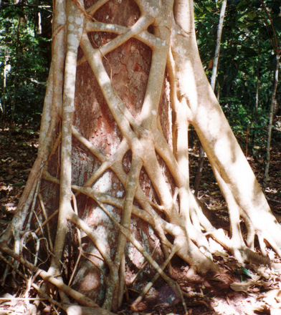
Strangler (fig) pattern
Martin Fowler
Notes:
Sometimes it’s called The strangler pattern comes from Martin Fowler
refers to the Strangler Fig, which starts in the upper branches of a host tree
Grows and grows and eventually overtakes the host tree, strangling it
But “strangler” is a pretty violent term, and I avoid it for that reason.
Martin Fowler does too

Slide 21

Encapsulation
Notes:
Encapsulation is very similar
It’s the idea that you shouldn’t need to know how a system works to use it.

Slide 22
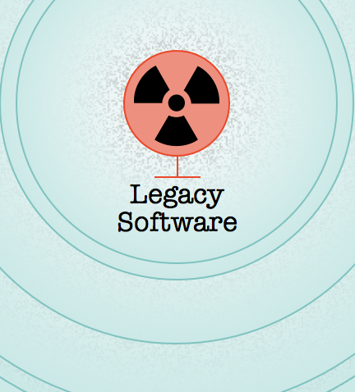
Encasement strategy
Notes:
The encasement strategy is a term we’ve used at 18F for a while
It relates fragile legacy systems to a radioactive nuclear site like Chernobyl
both are things that are scary to touch
It’s a bit hyperbolic, but this is the term I tend to use

Slide 23
The basic idea
Notes:
So here’s the basic idea

Slide 24
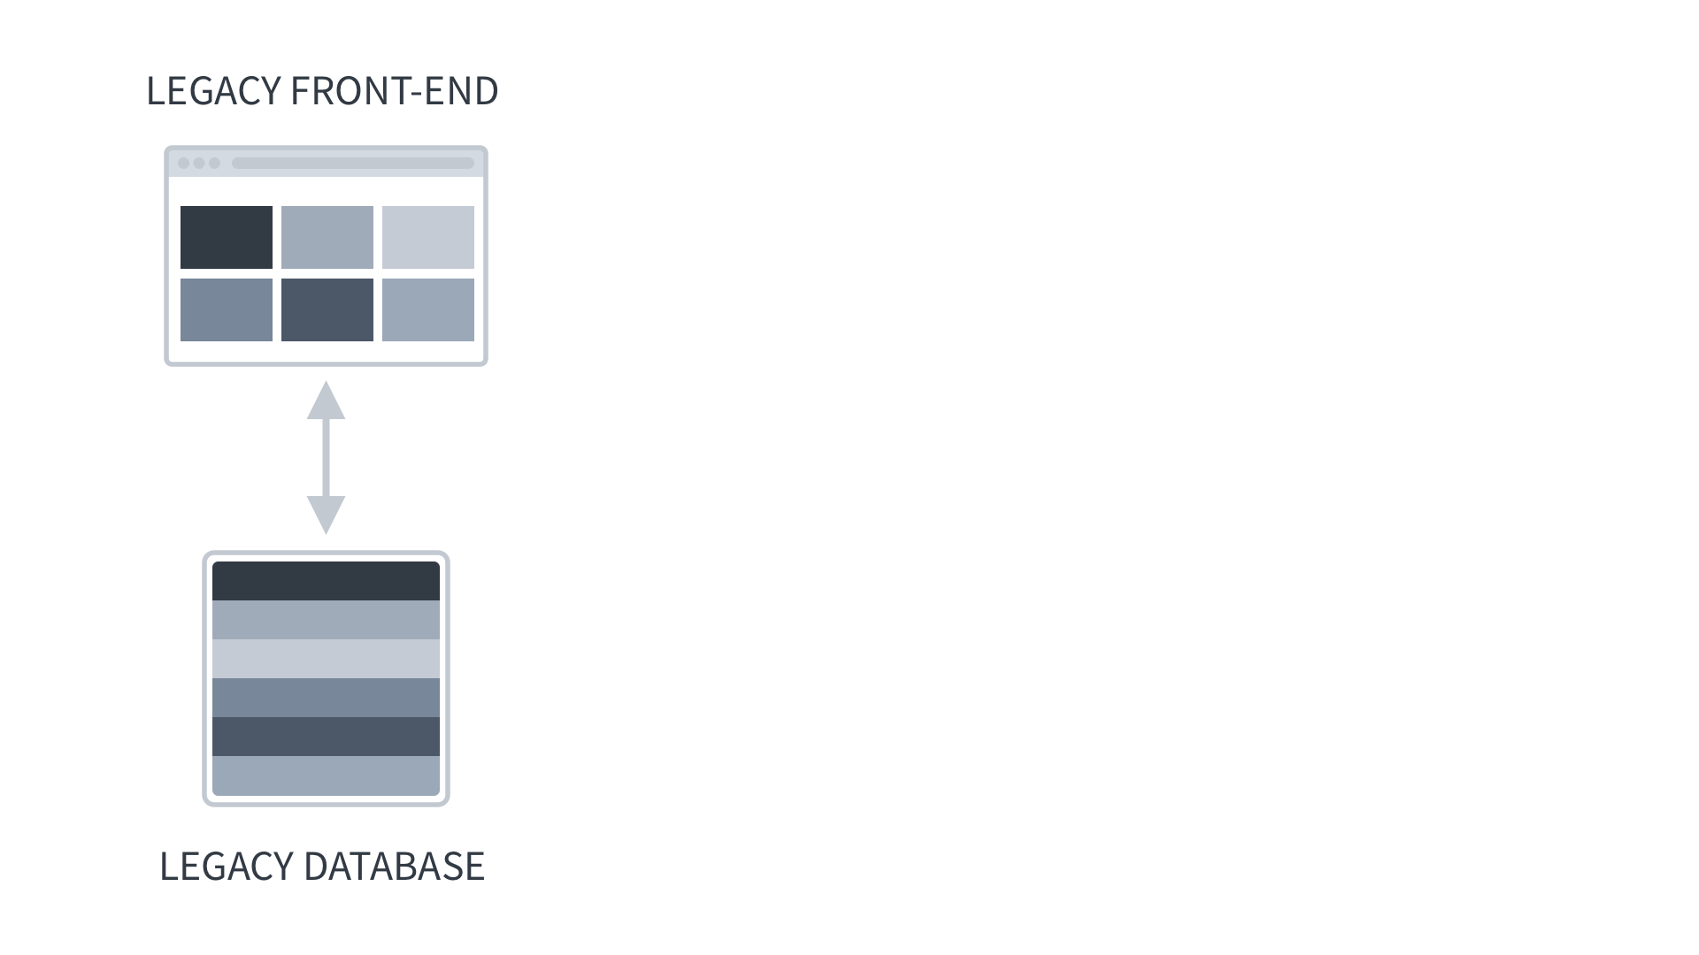
Notes:
Here’s the basic idea
You’ve got your existing system, a front-end interface and the backend components
They’ve been around for a long time, have a bunch of brittle pieces, and people are afraid to change it too much because everyone relies on it and no one is sure how it all works

Slide 25
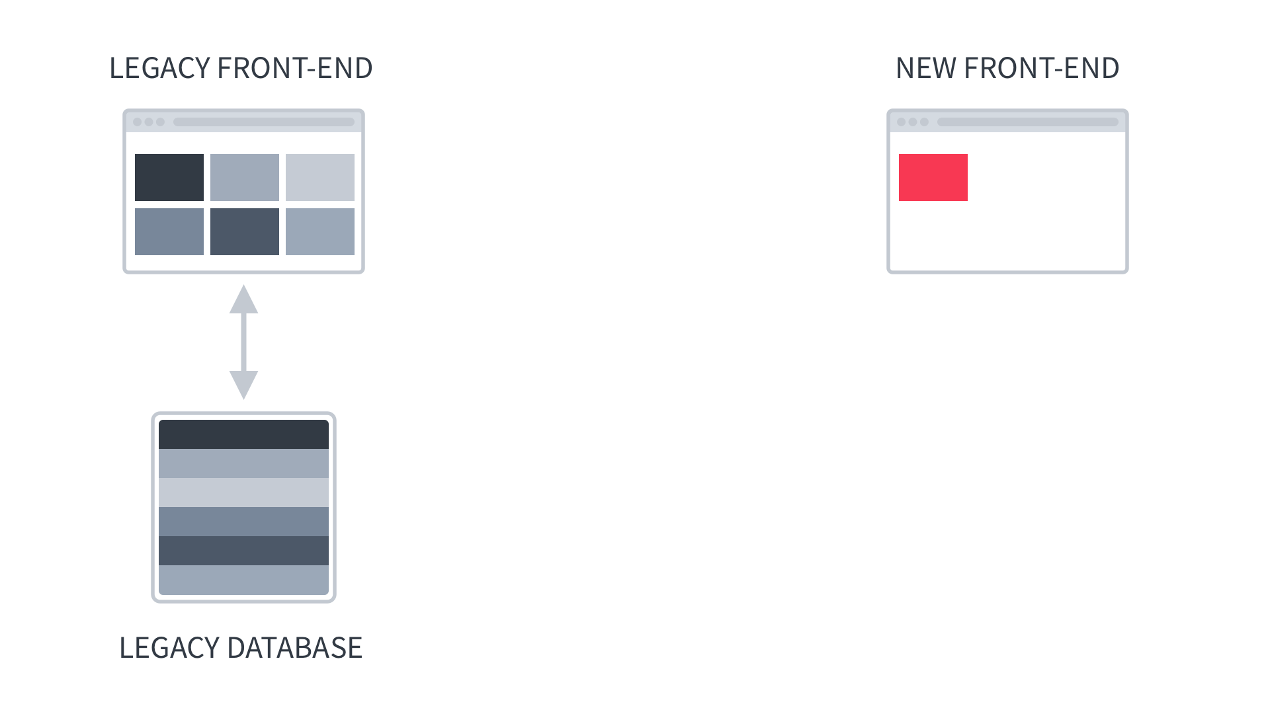
Notes:
Using the Encasement strategy
If you want to build a new component, you build new functionality next to the old system, without really touching it too much

Slide 26
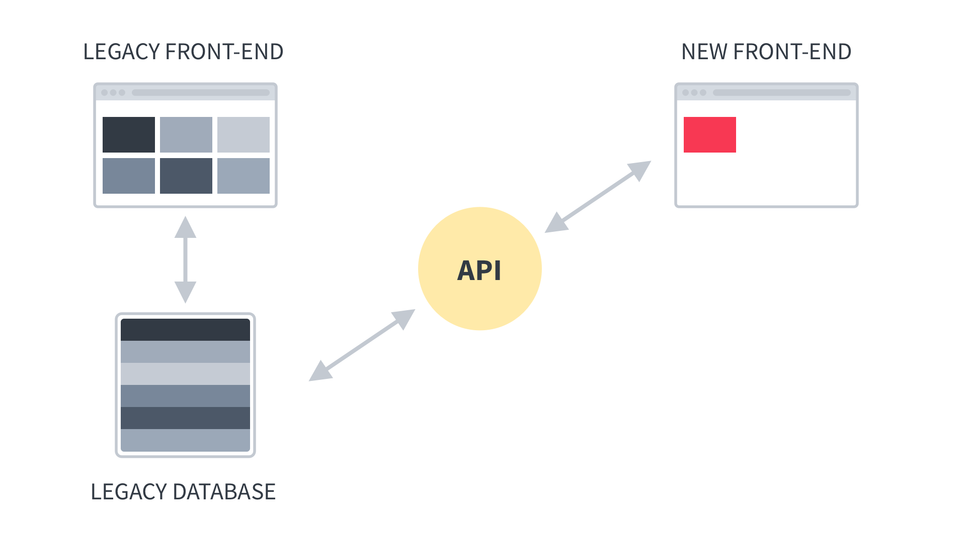
Notes:
In order to use data or functions from the legacy system
An API layer is built.
API means Application Programming Interface, and in general is a way for one application/program/system to interact with another
The API here is sort of translation layer between systems, allowing them to communicate regardless of the technology used
It allows the new system to send and receive the necessary data without having to worry about what’s going on inside the old system
It also acts as a pivot point, loosely coupling the new system to the legacy system

Slide 27
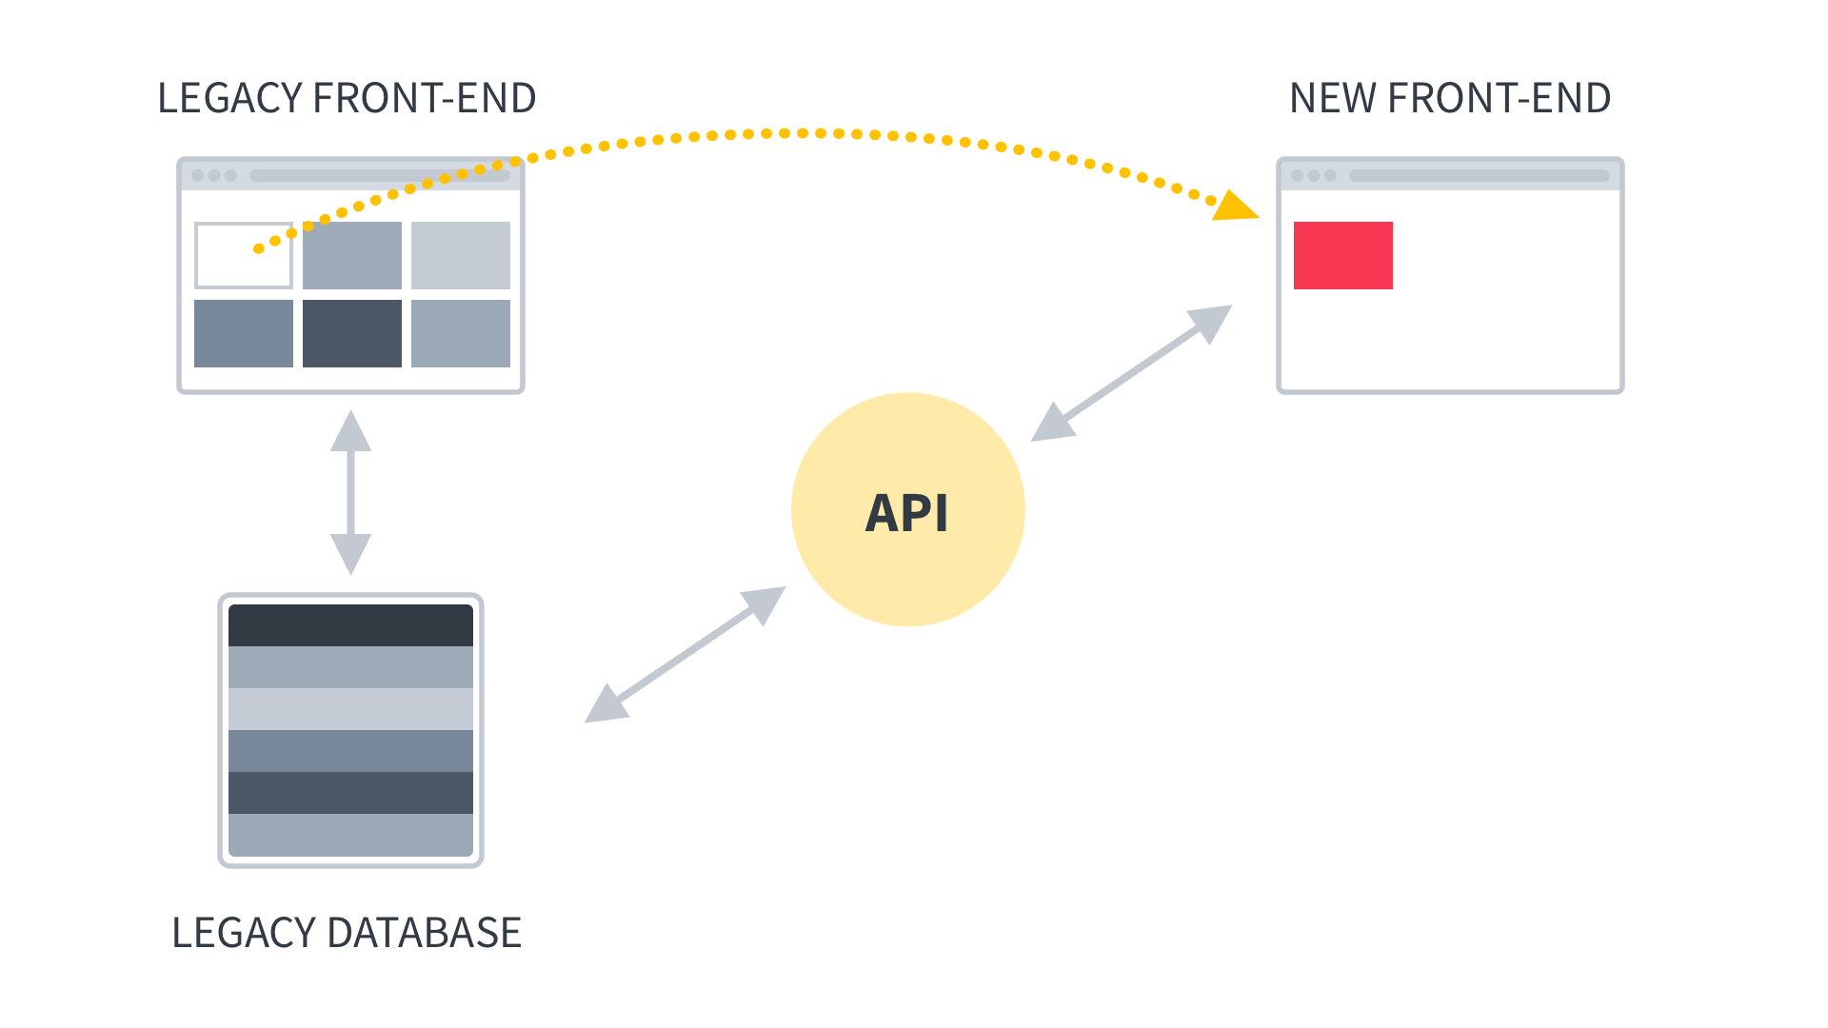
Notes:
New functionality gains adoption
You turning off old functionality as it is replaced

Slide 28
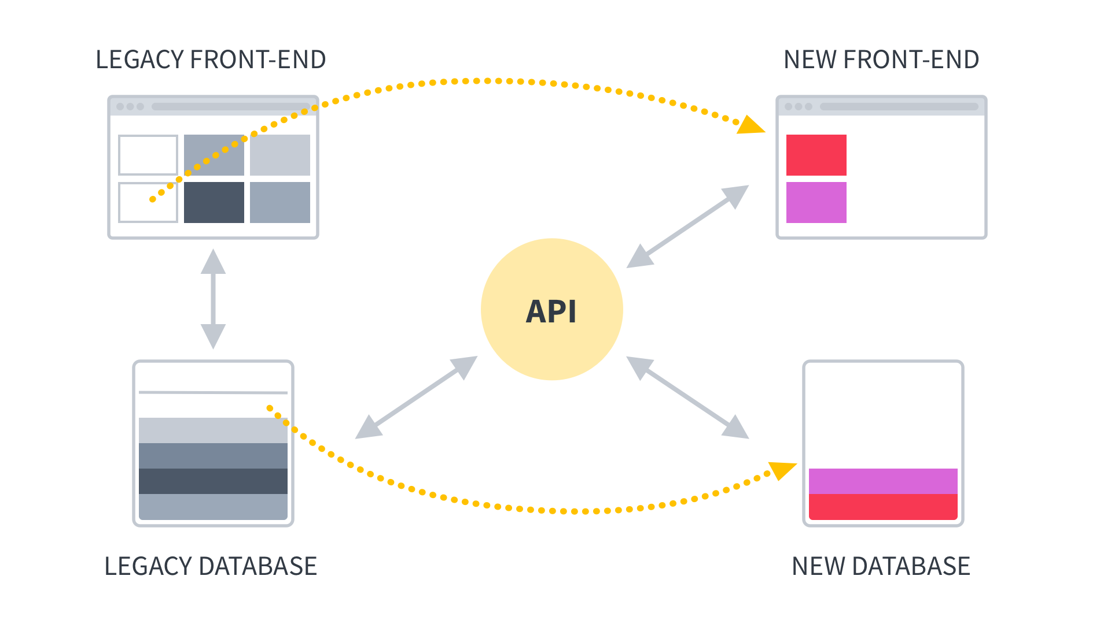
Notes:
You do the same thing with the backend systems
Gradually shifting responsibilities from the old backend to new backend

Slide 29
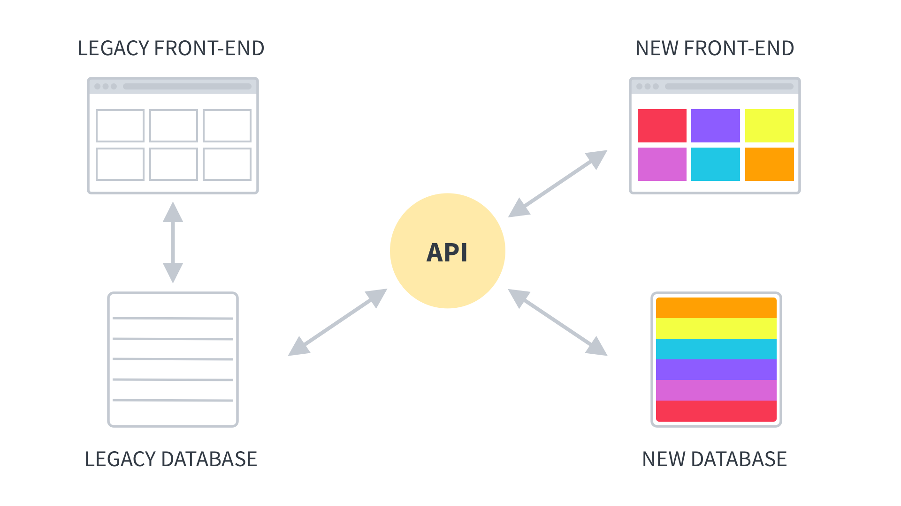
Notes:
Once you’ve shifted all the front and back end functionality over to the new system,

Slide 30
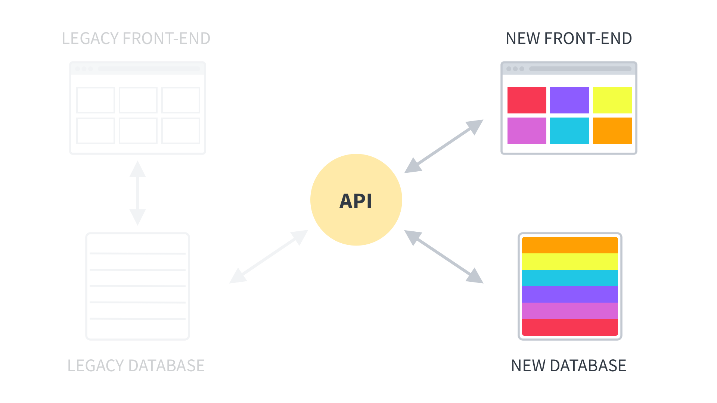
Notes:
You can shut down the old system
That means you can shut down that on-prem data center, having moved everything to the cloud
Or dedicate ongoing resources to run all the manual processes
(other modernization goal)
There was no big bang launch here, just gradually rolling out new features, turning off old parts, until you finally have everything modernized
But really, this image is a bit of a lie

Slide 31
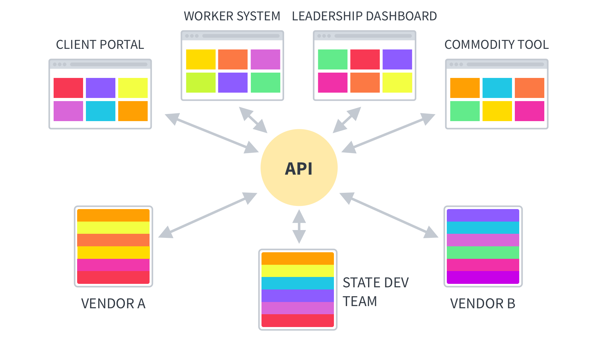
Notes:
Developing this API layer opens up a wide range of possibilities
The ability to build separate, smaller, more focused tools
Involve multiple vendors in smaller procurements
Leverage in-house talent to build components
This is what we mean by “loosely-coupled architecture or systems
Different components, interacting with each other through well-defined APIs
each system doing its own thing, blissfully unaware of the other systems
but getting everything they need through the APIs

Slide 32
Looking a bit deeper
Notes:
So now let’s look at how the encasement strategy can actually transform an application people use

Slide 33
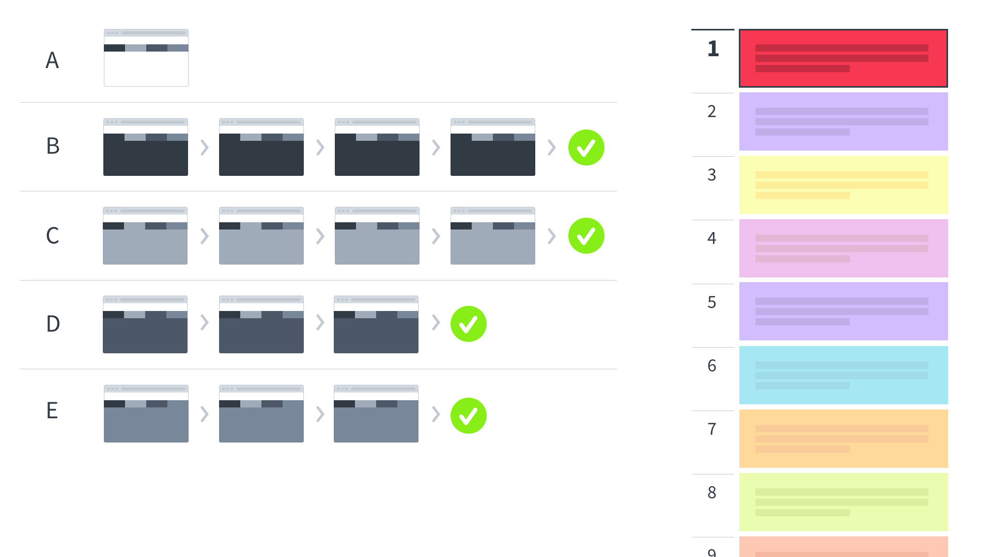
Notes:
So here is our legacy system
Let’s say this is an application eligibility workers use to do their work

Slide 34
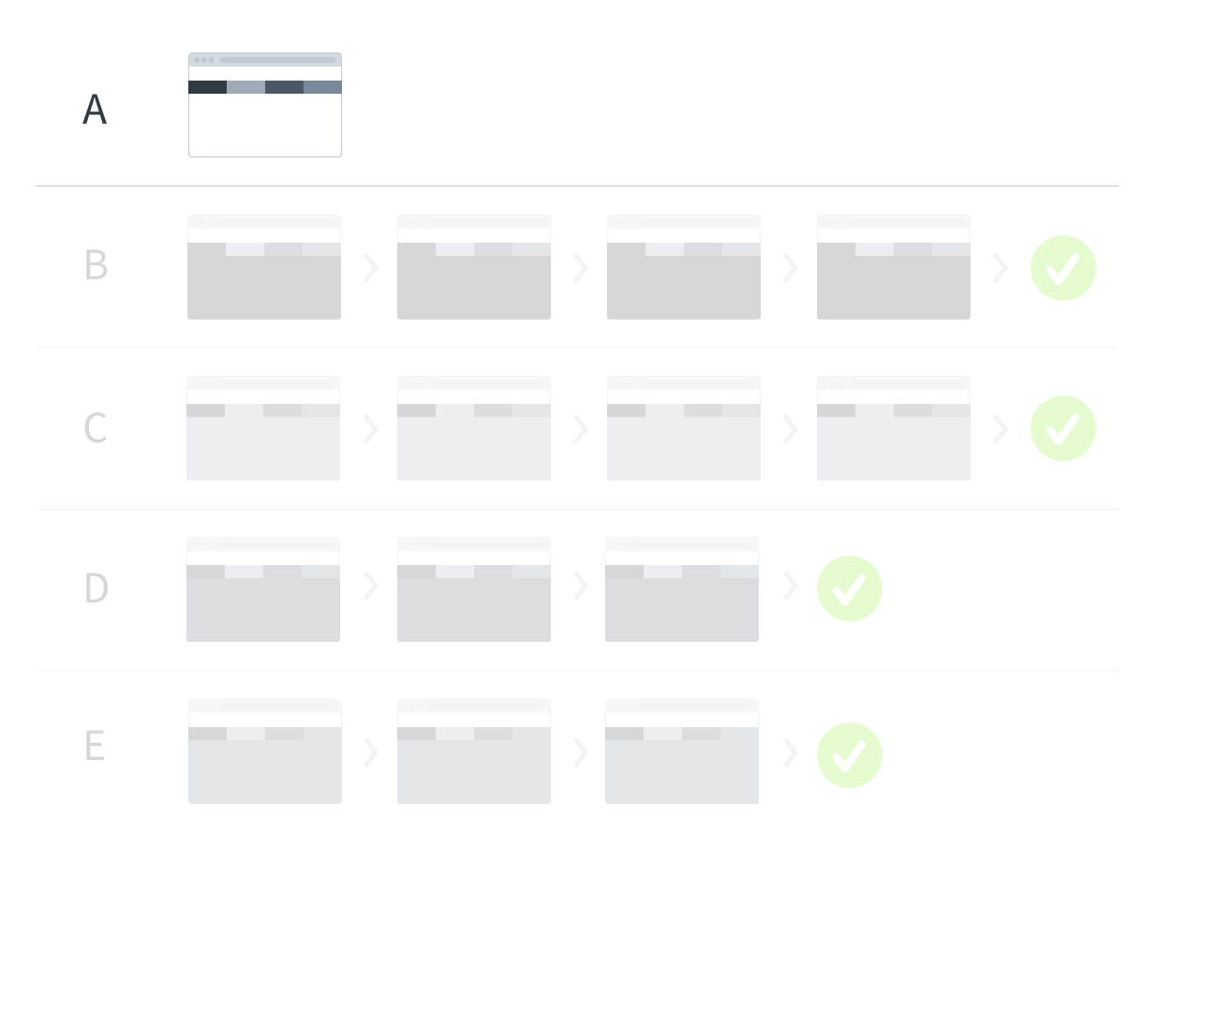
Notes:
We’ve got a homepage or start screen.

Slide 35
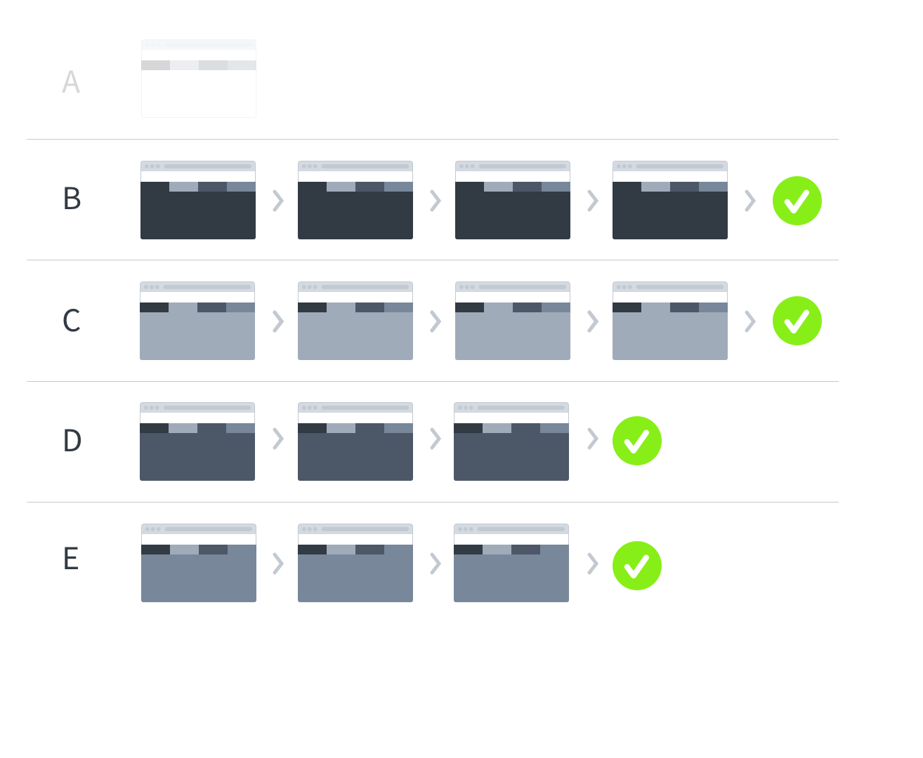
Notes:
We’ve got four tasks, or complete series of steps that a user needs to take to accomplish a piece of work.

Slide 36
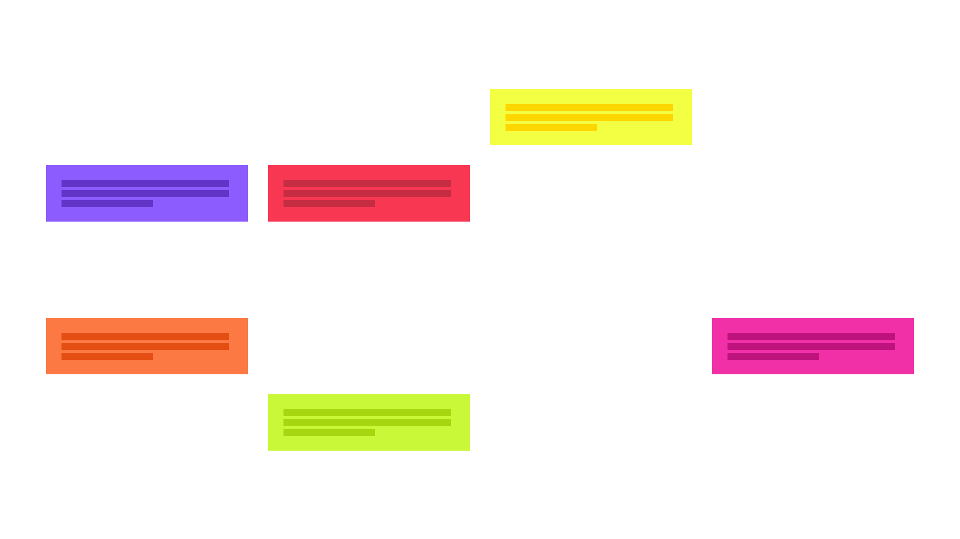
Notes:
And then we’ve got work we know about
things we know we need to improve

Slide 37
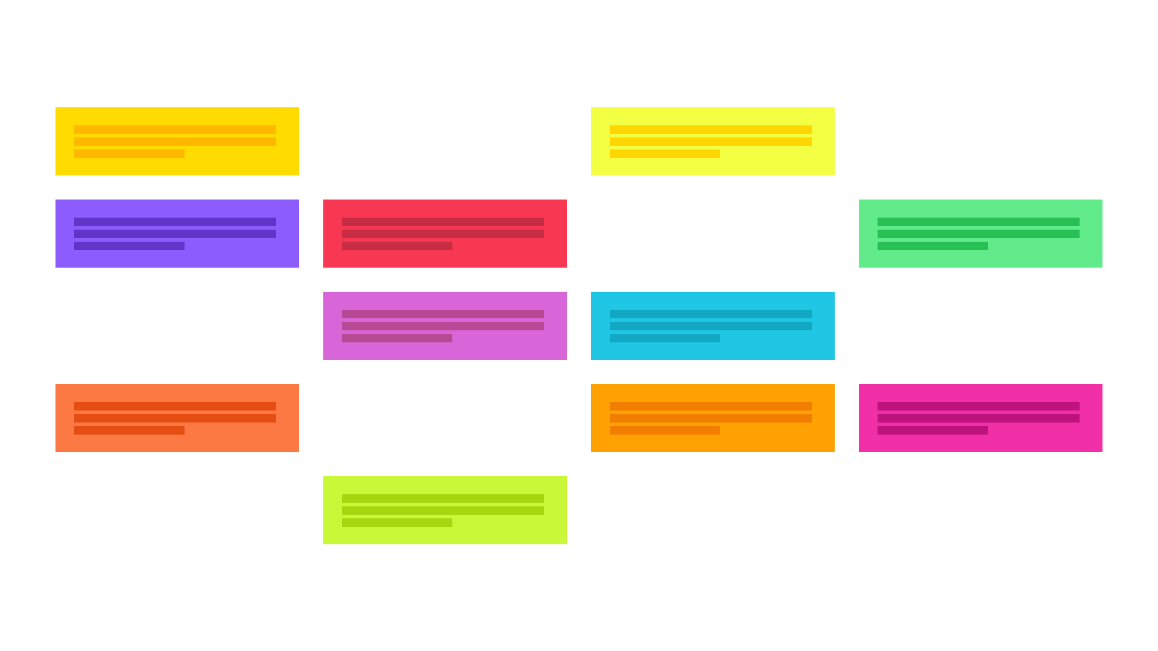
Notes:
And things we learn through research with or users

Slide 38
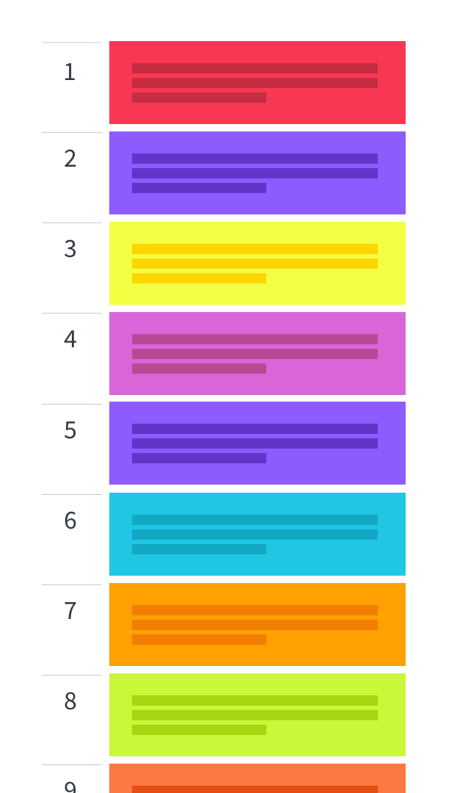
Notes:
The first thing we have to do is prioritize our work
This is part of adopting a “product” mentality
This is about more than technology
can’t do everything at once
Need to direct our work
We create a prioritized backlog of work
constantly re-evaluate
Not a sequential order burning fires

Slide 39
At first, focus on learning and don’t bite off too much
Prioritize meaningful new pieces that aren’t too hard
Build confidence in developing new APIs and building this way
Stick with read-only functionality until you’re comfortable
Notes:
Early on, we’ll want to prioritize learning
existing data
our old backend systems
building with agile methods
new technologies such as cloud environment,
deployment methods
security requirements
Pick
meaningful things
deliver real value to users
don’t bite off too much
Also pick things that help you gain confidence
building your new APIs
knowing you can deliver this way
focus on reading data from your old systems, maybe hold off on write activities

Slide 40
Notes:
old application and our prioritized work
red box = new task/module/procurement
in the top priority slot.
We’ll work on that first.

Slide 41
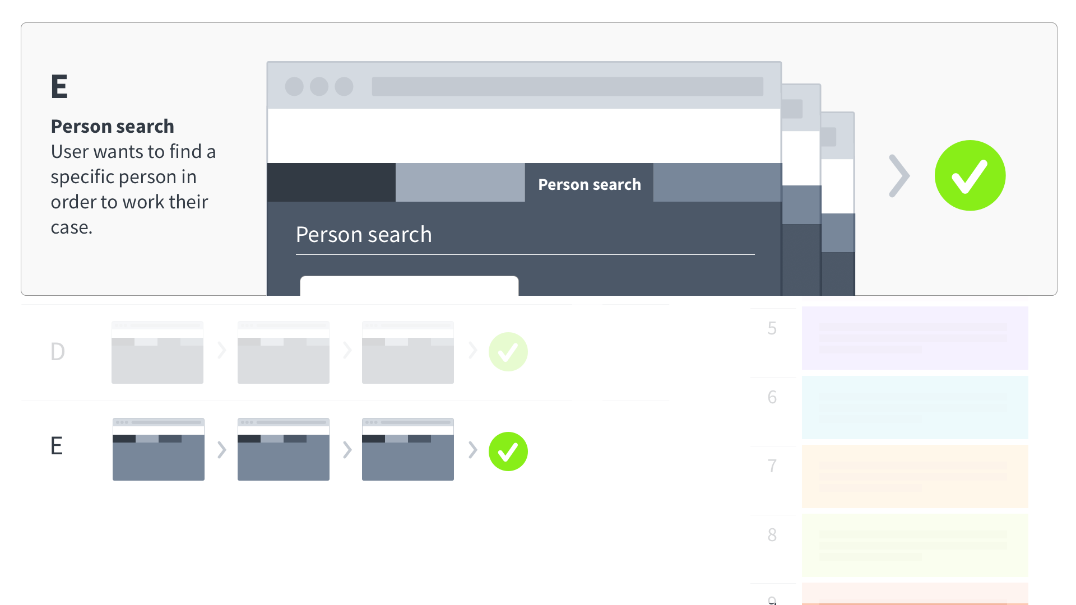
Notes:
searching for a person
where a user looks for a specific person to work their case.

Slide 42
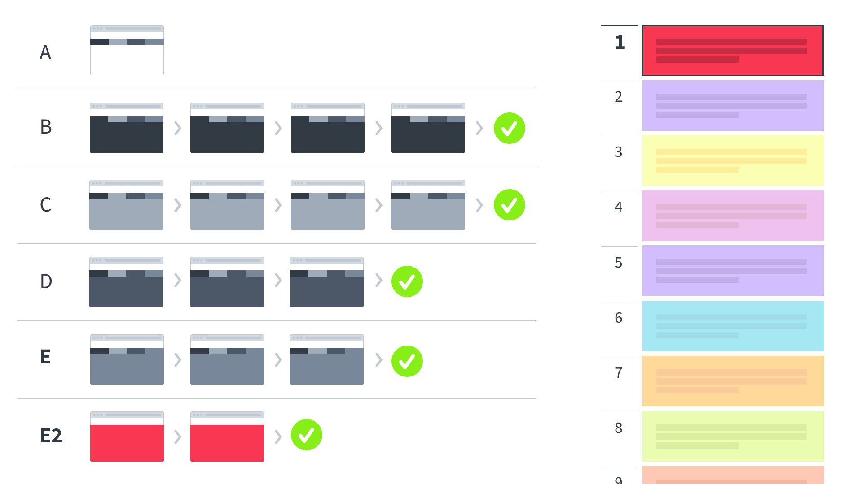
Notes:
We introduce the new module to our system.
We’ll call it E2.
It’s an alternate experience that focused on the same task as the legacy E task.
We launch it alongside the existing workflow.
Users can use either the old method or the new

Slide 43
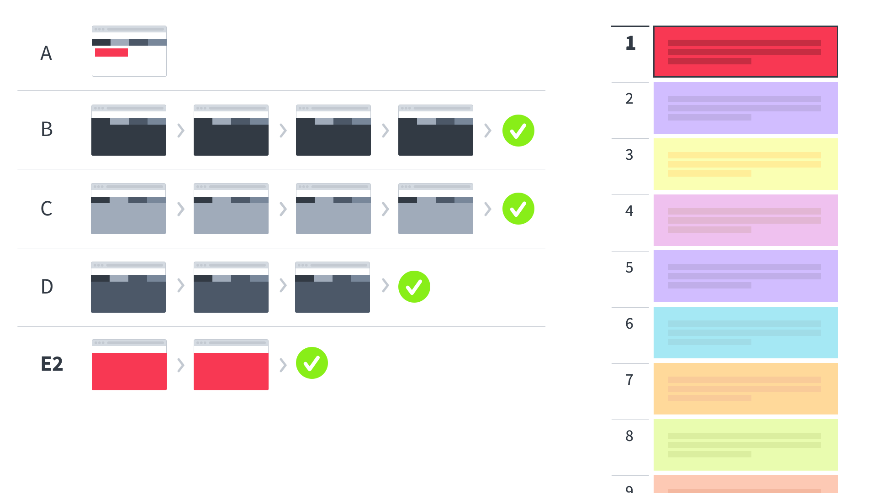
Notes:
Once E2 has been adopted, the legacy E experience can be hidden.

Slide 44
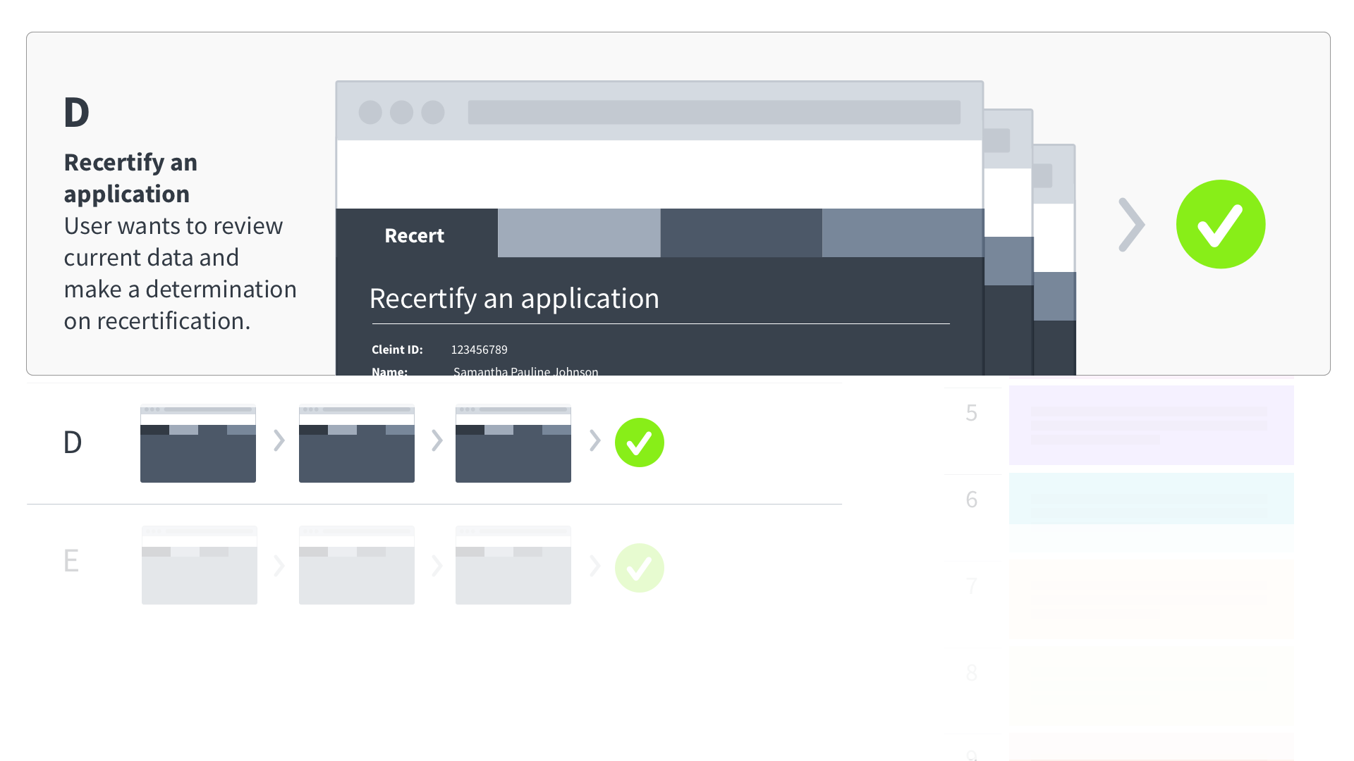
Notes:
Maybe our next task is recertifying eligibility

Slide 45
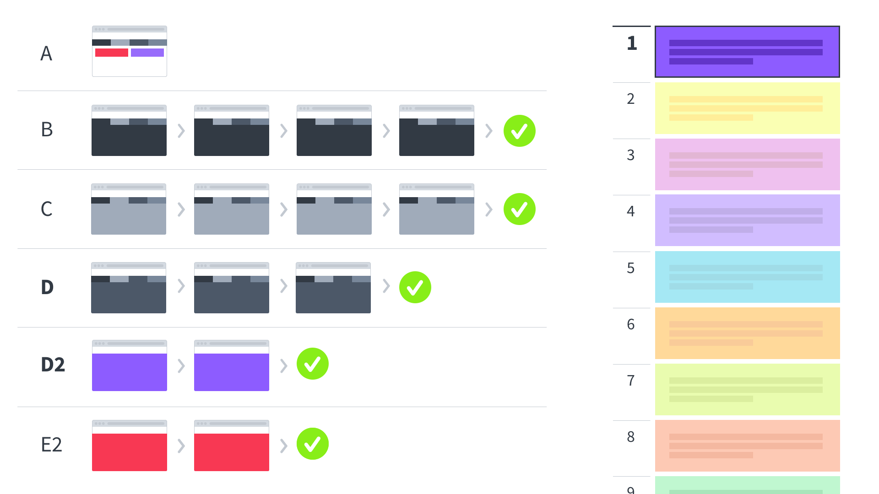
Notes:
We introduce the recertification workflow
Shown here as D2.

Slide 46
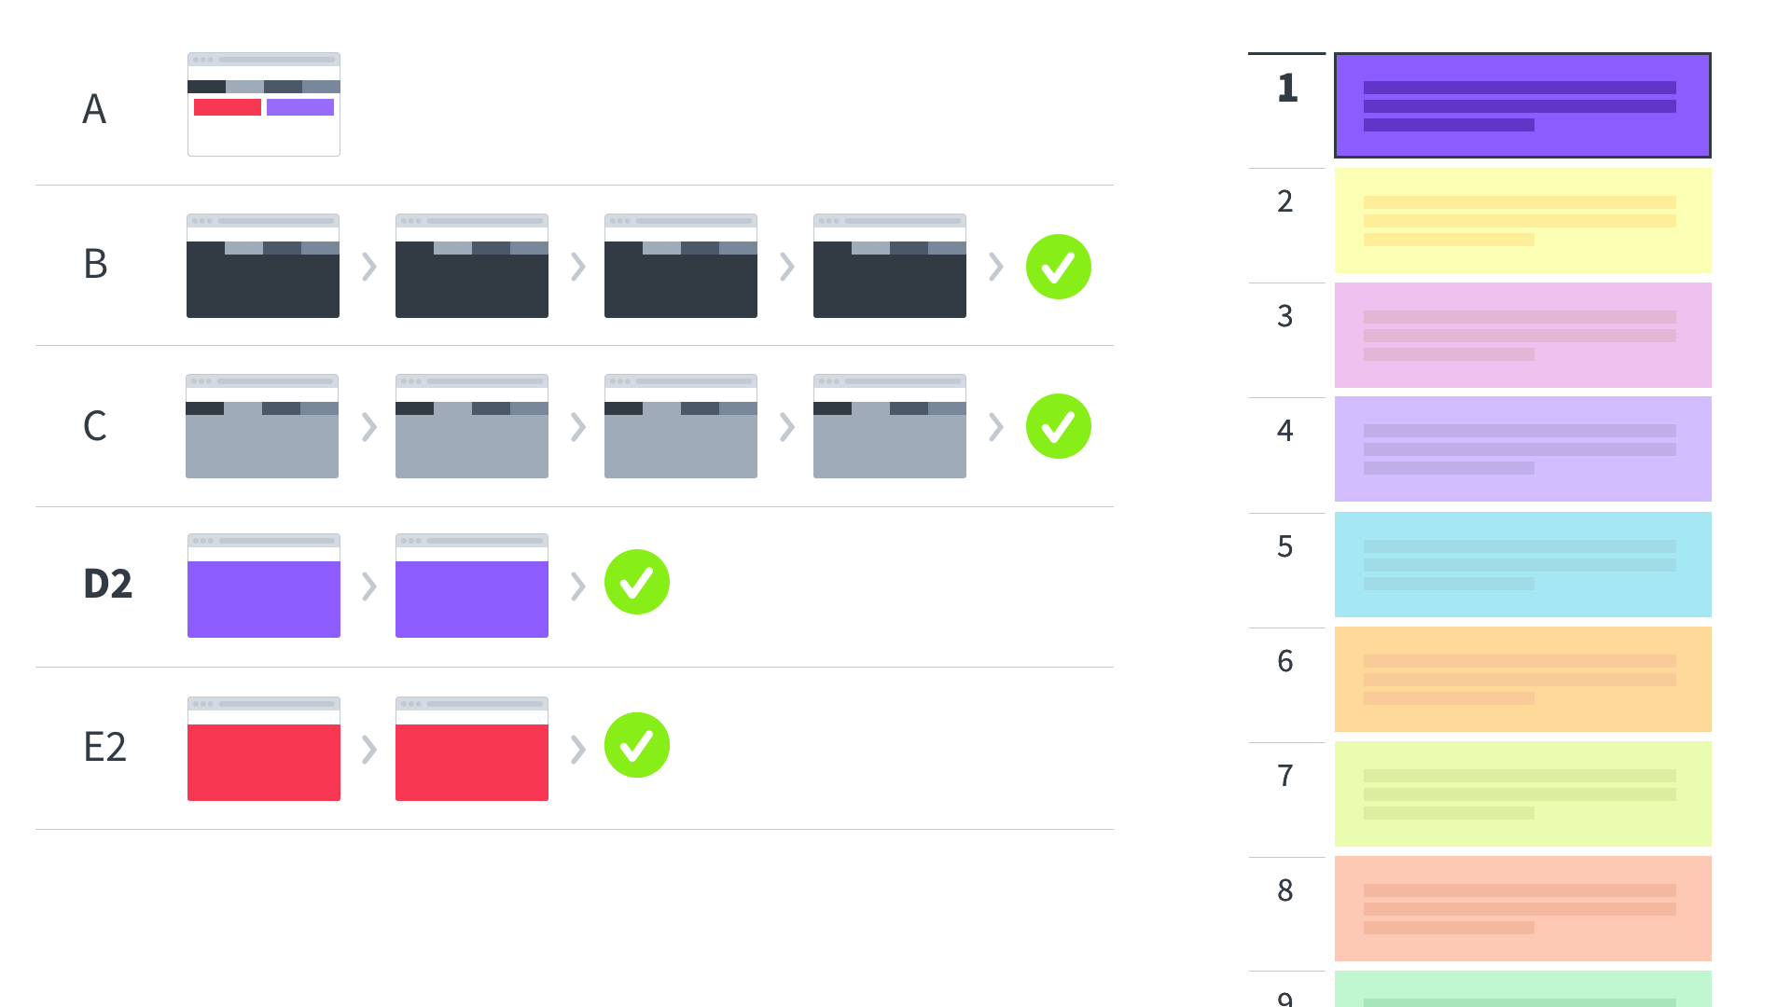
Notes:
With adoption of the new recertification, we hide the legacy D experience.
Note how we’re shifting responsibilities from the old system to the new one.
And we’re running them alongside existing legacy experiences

Slide 47
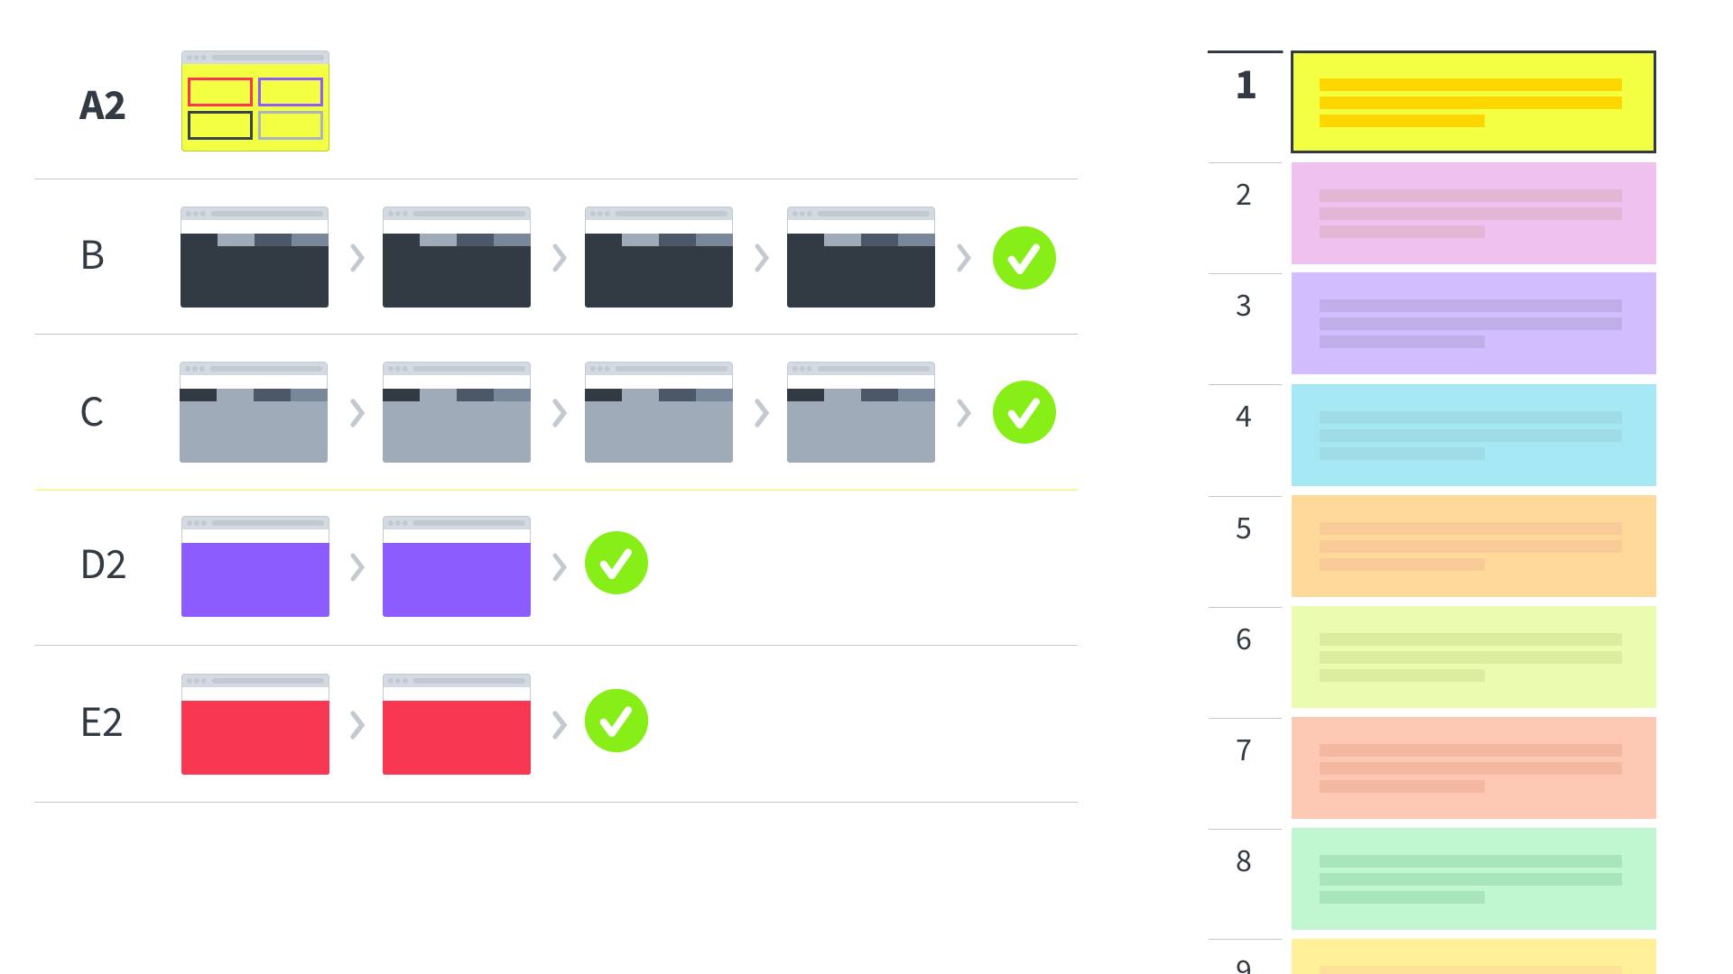
Notes:
New priority is focused on a new homepage
The new homepage module provides navigation to both legacy and new experiences.

Slide 48
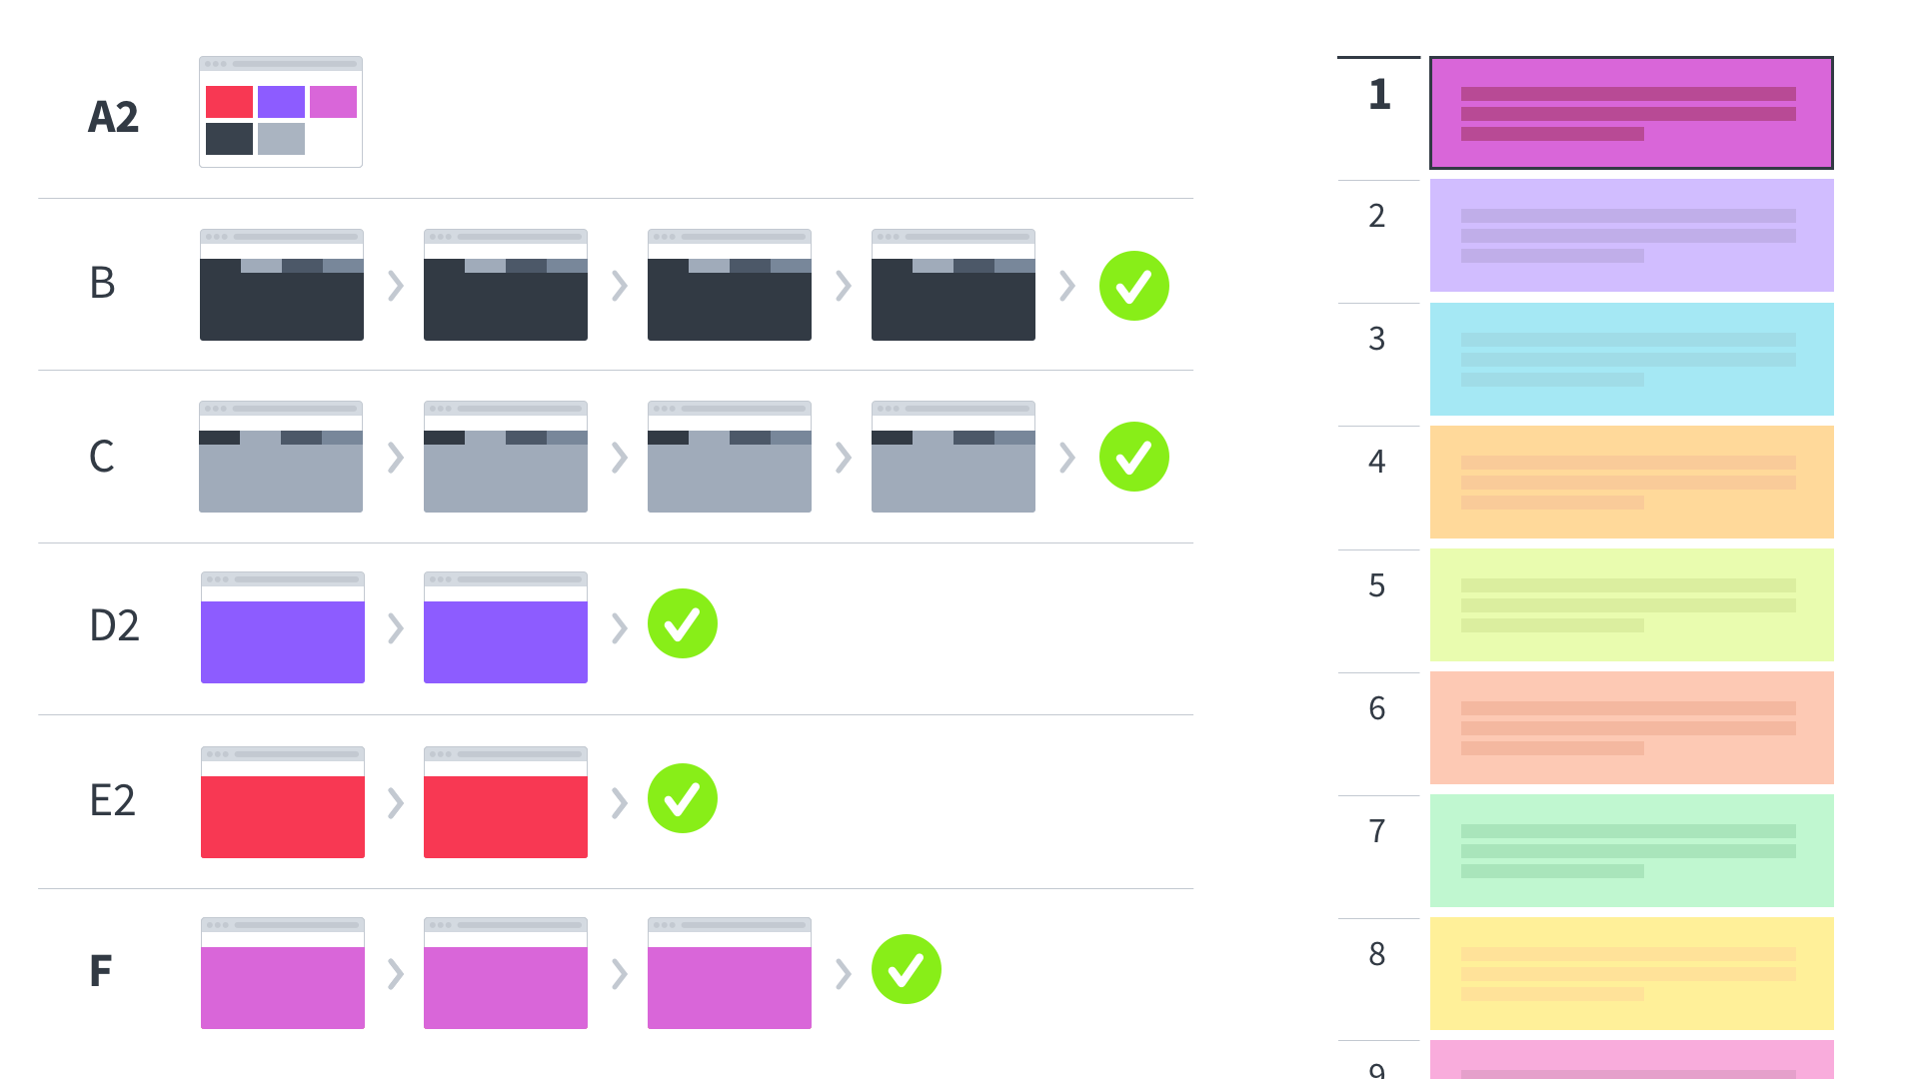
Notes:
Maybe we add new functionality not in legacy

Slide 49
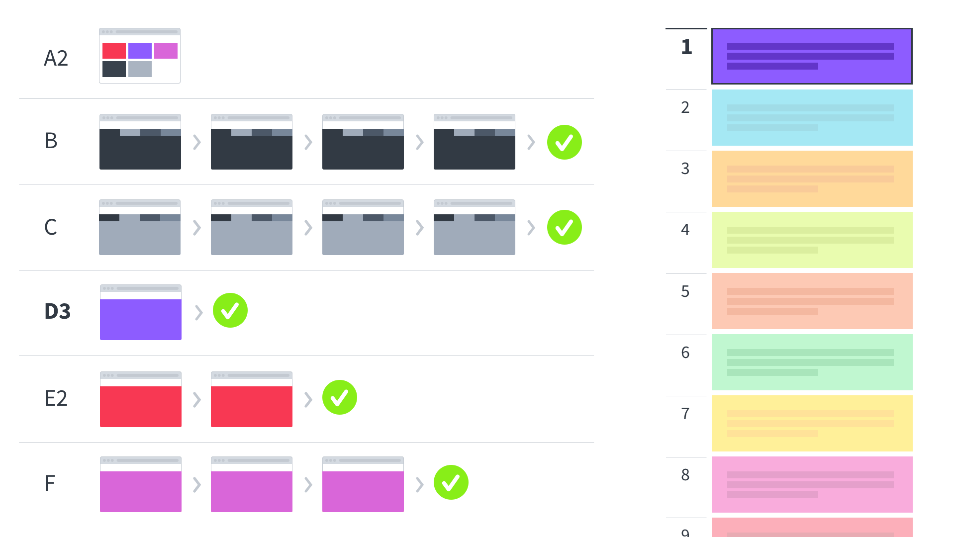
Notes:
Them maybe we improve one of our new tasks further

Slide 50
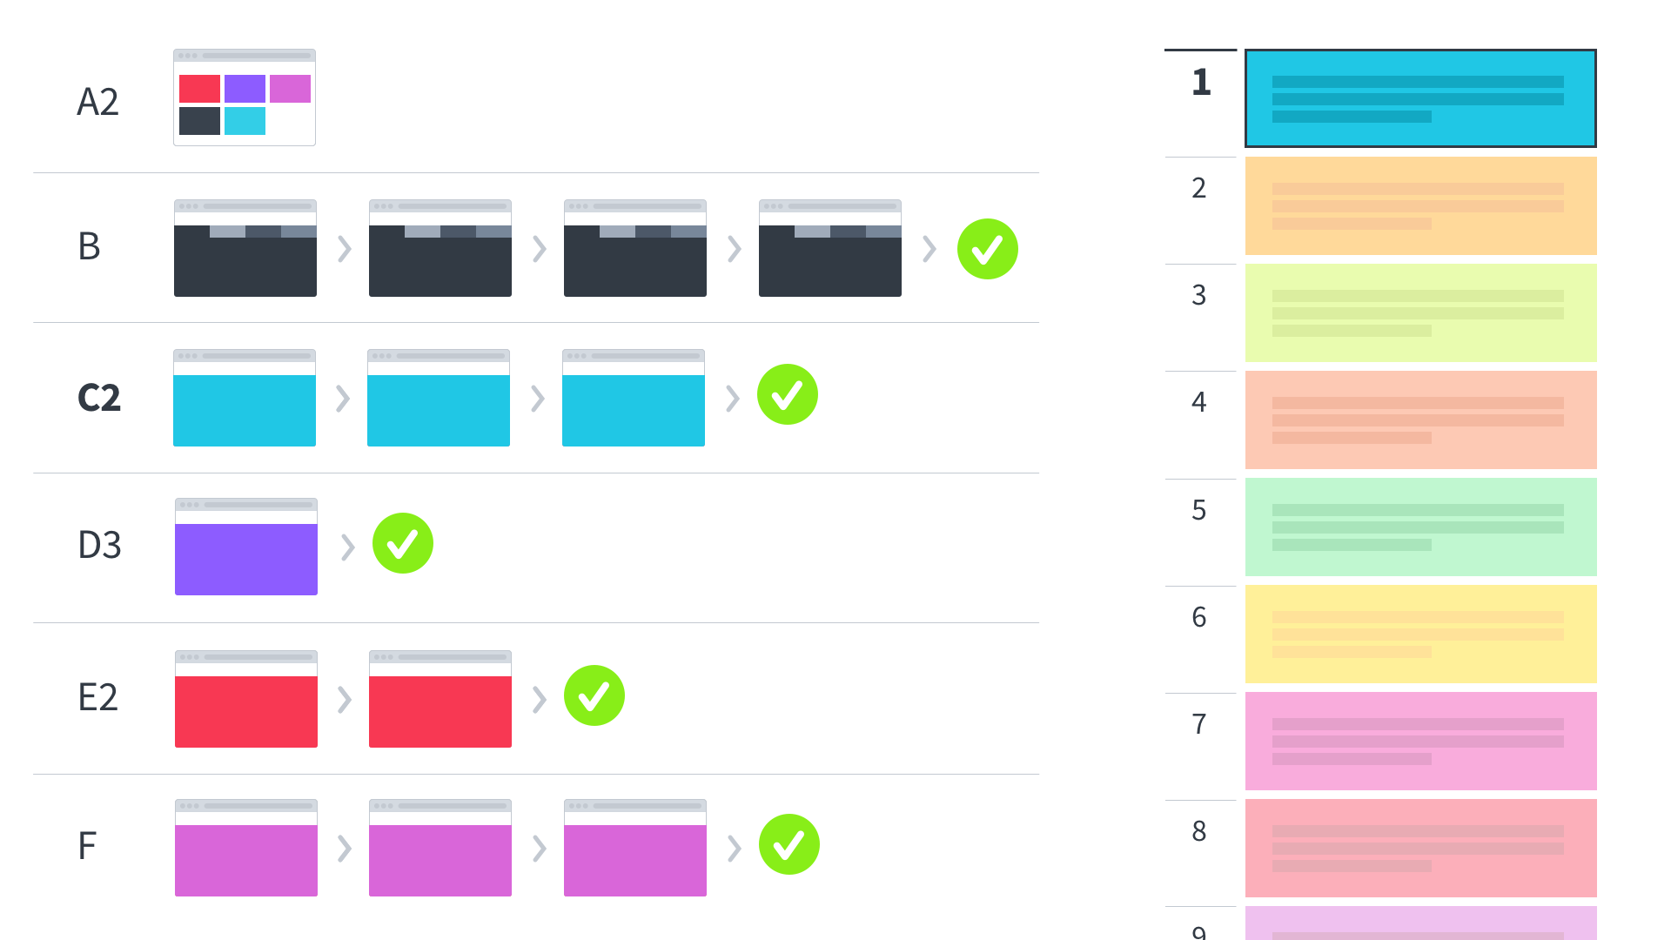
Notes:
And then we replace another workflow

Slide 51
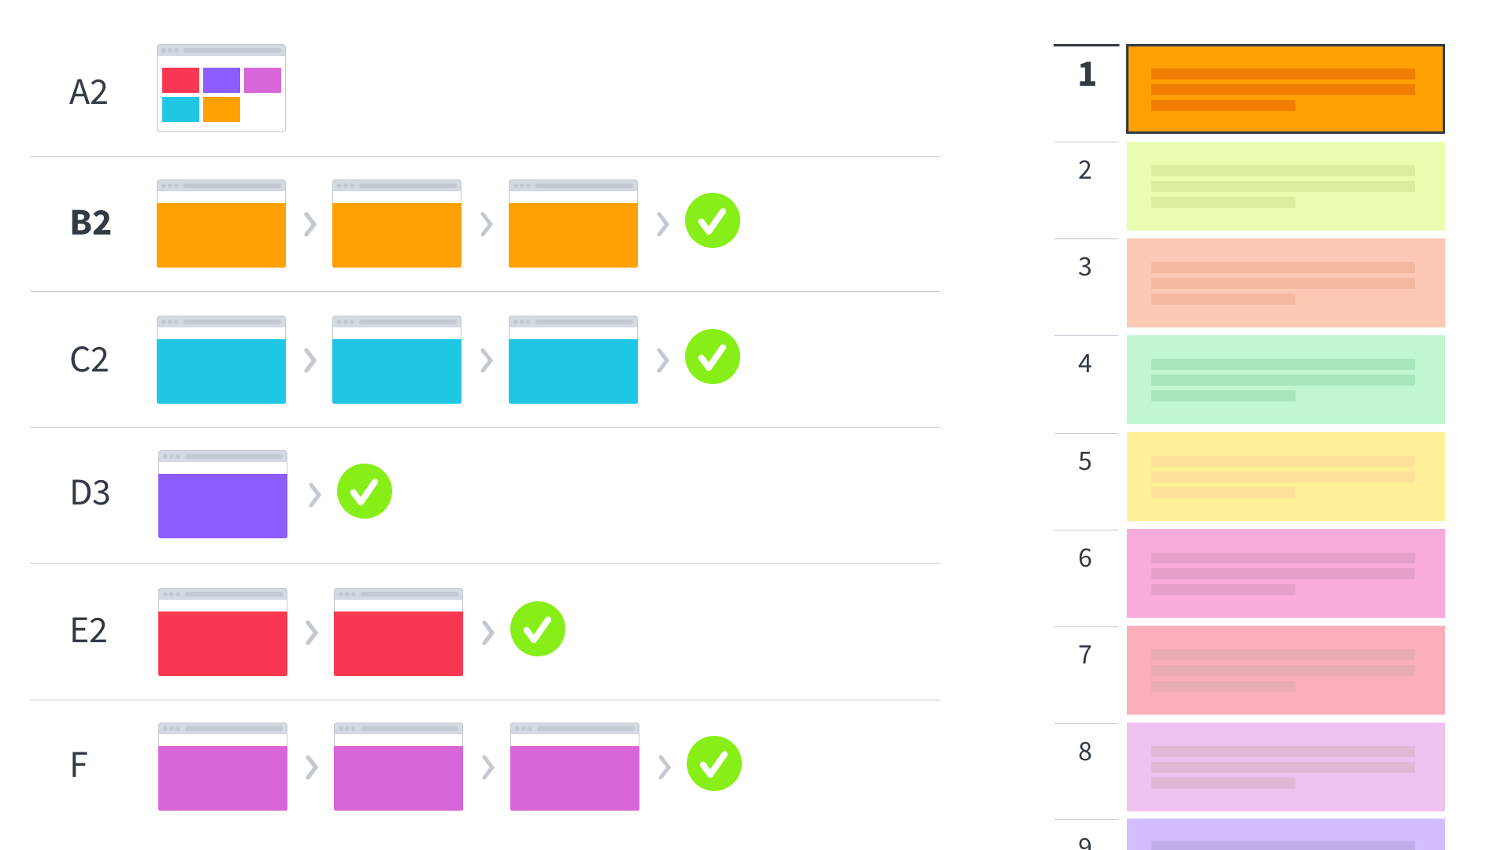
Notes:
And another

Slide 52
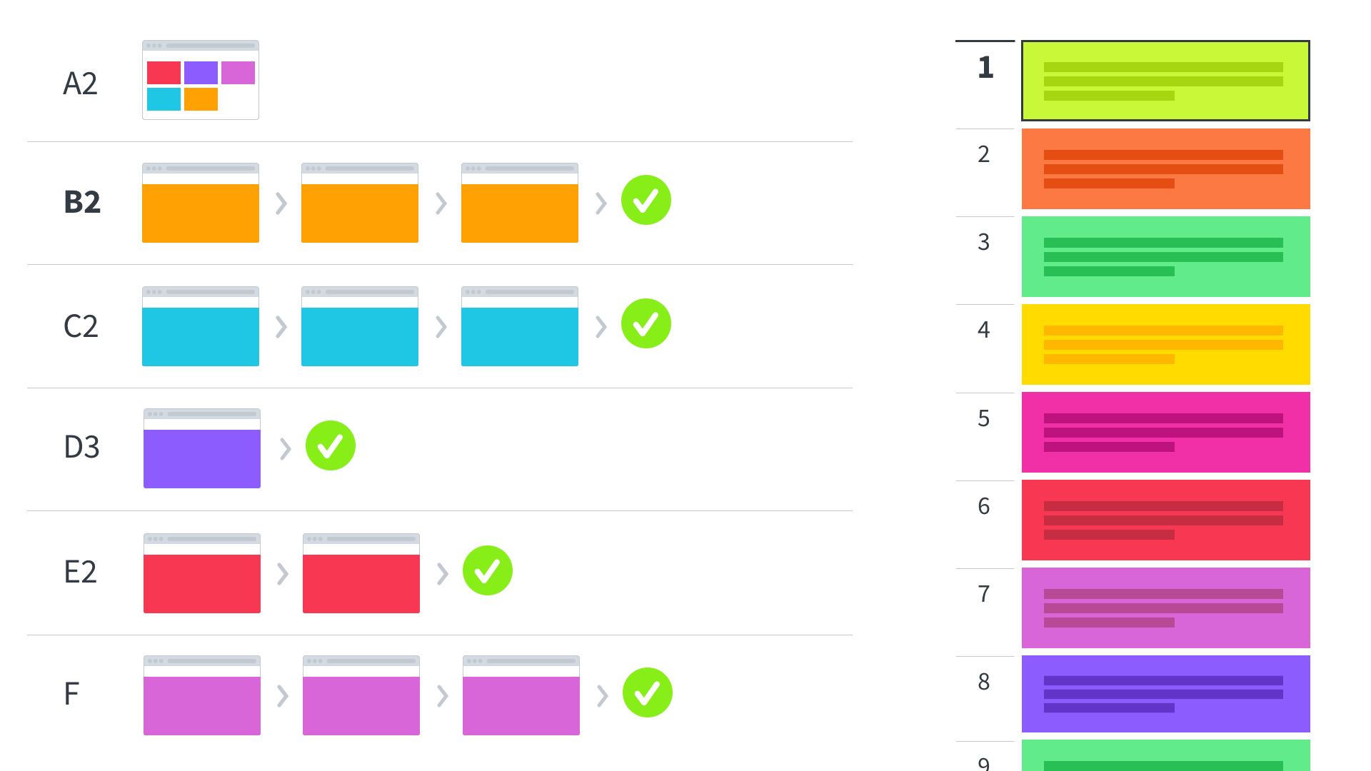
Notes:
After launching a number of modules,
we have a system that’s been iteratively transformed.
We maintain a roadmap
continue making incremental improvements.

Slide 53
But won’t this lead to a disjointed experience during the transition?
Yup.
Notes:
Will experience be disjointed?
some tasks in old way and some in new?
Yup. that’s fine.
Forward motion is better than perfect consistency.
Here are a few tips that make it manageable

Slide 54
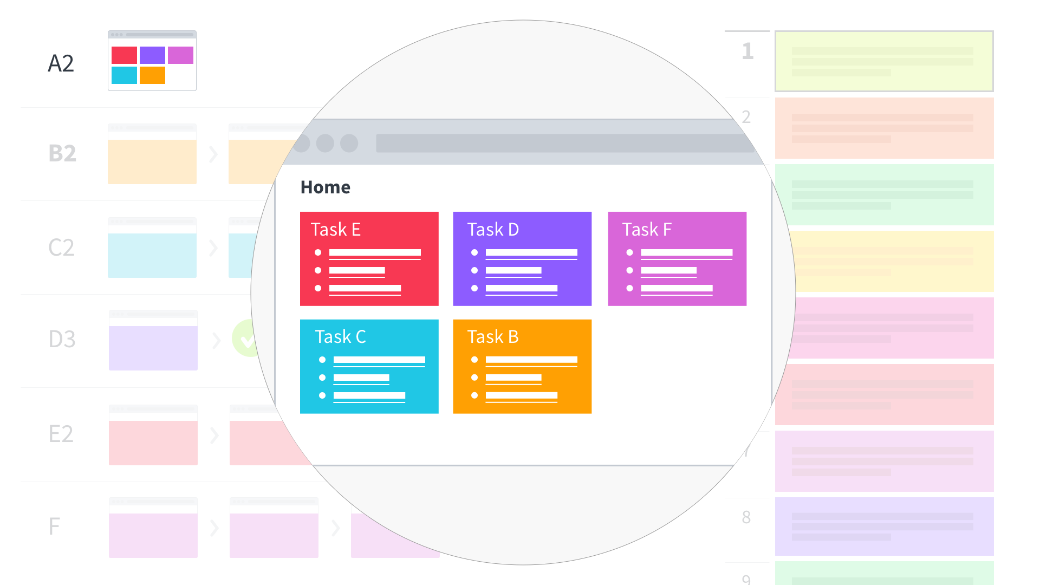
Notes:
Use the homepage for navigation
facilitate global navigation
aggregating links to anything necessary up front
You can avoid updating all you global navs by teaching folks to navigate from the home

Slide 55
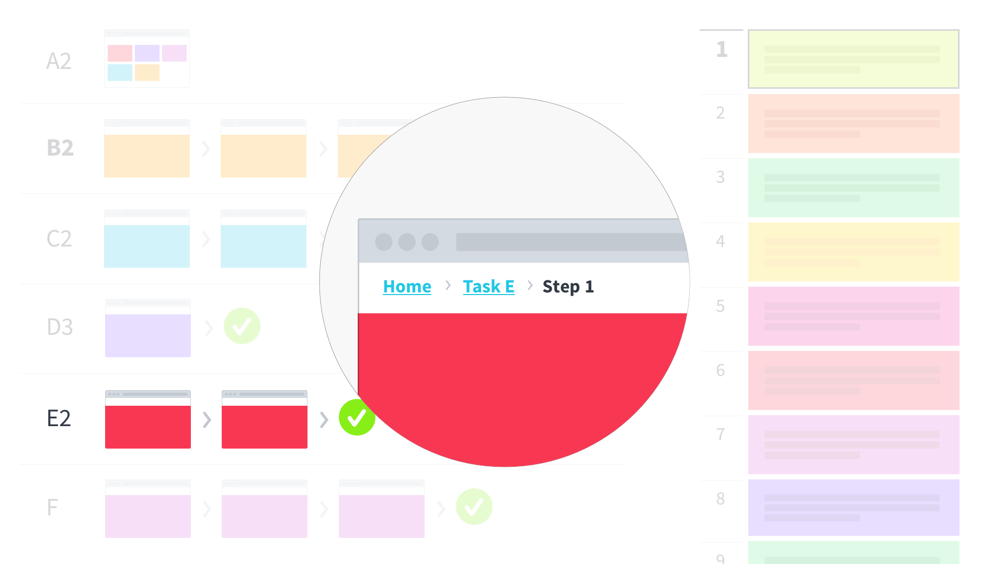
Notes:
Navigation is always difficult.
Once set, it can be difficult to change.
Users get used to it. Stakeholders fight over it.
Adopting a “hub-and-spoke” approach to global navigation.
Teams building a module don’t need to think about global nav,
just link back home.

Slide 56
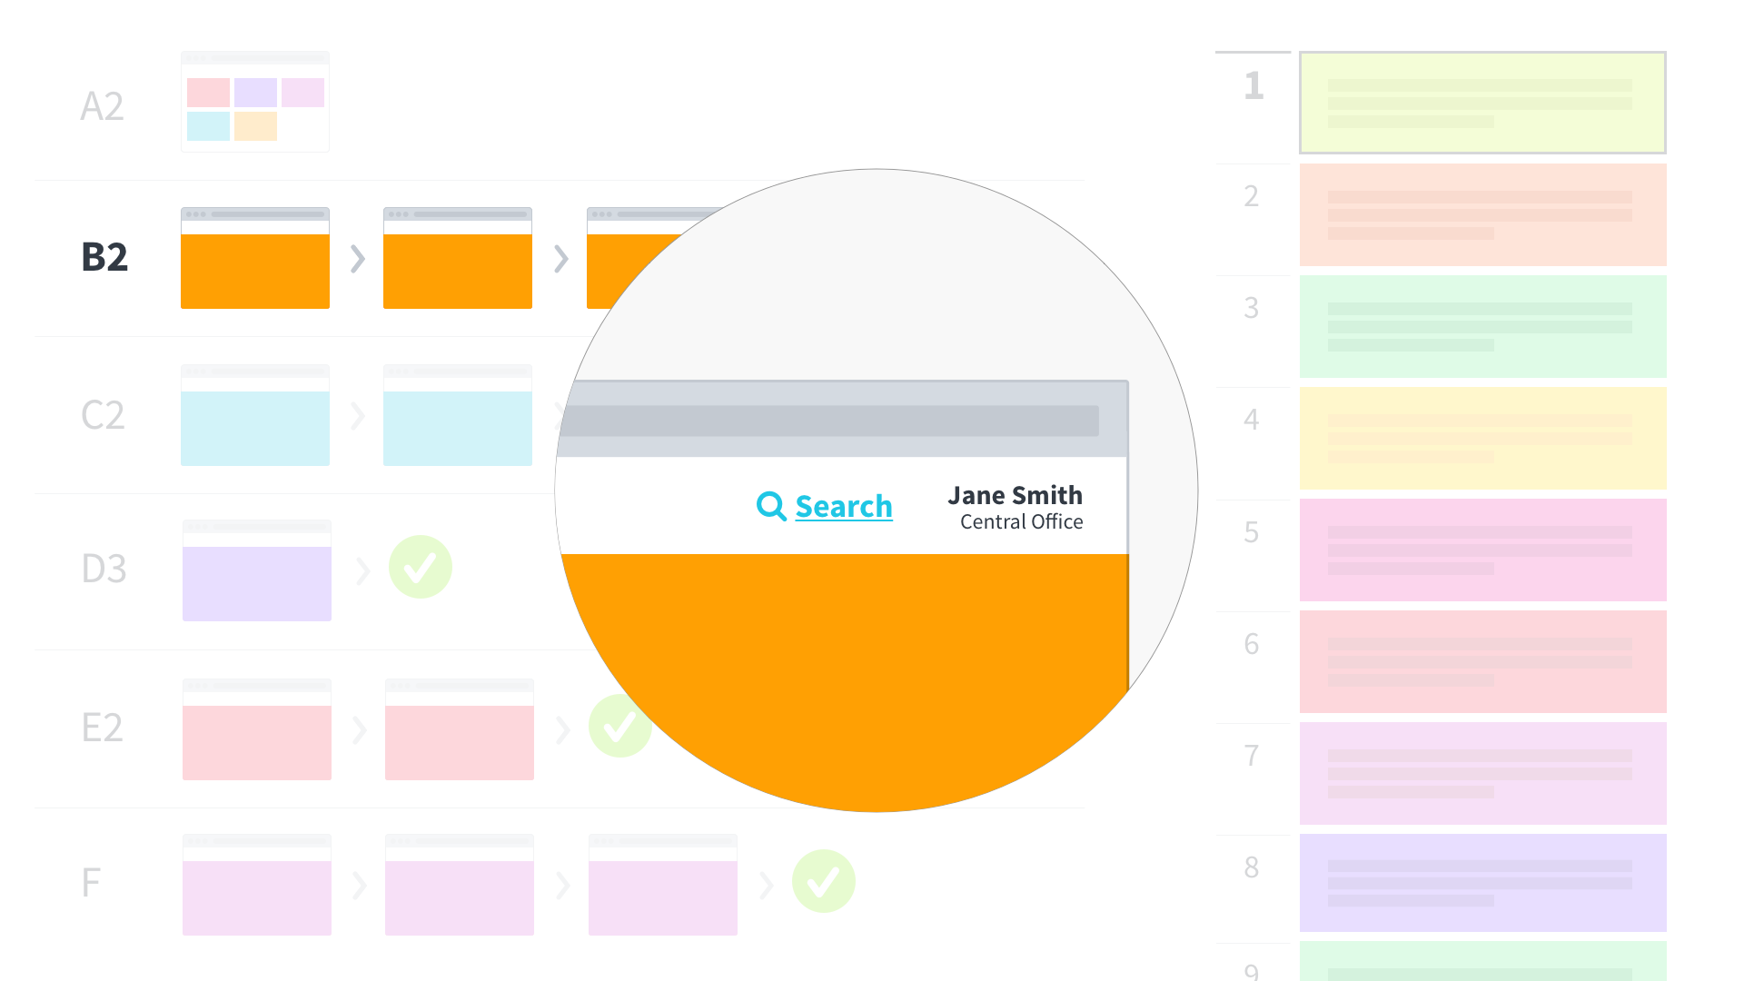
Notes:
Some services will need to be exposed across pages:
Each module needs to be aware of the user’s identity.
Use search is a first class means of navigation
accessible in each workflow.

Slide 57
This will look different if your legacy system is a mainframe green screen or desktop application.
Notes:
will look different if the application interface you are updating is not a web-based application
If you have a green screen system or software that is installed on each eligibility worker’s computer
You’ll do it a bit differently
Users can’t just follow links between old pages and new
Context switching is real
Still, follow a similar process
Identify meaningful tasks that can be built anew
fully be completed in the new system to avoid context switching.

Slide 58
What are some of the implications?

Slide 59
Optimized for change
Notes:
You’ll be optimized for change
Priorities change
You should be able to respond to changing needs of your workers and clients
Building out that API layer makes that easier.
Optimized for change.

Slide 60
Deliver value faster
Notes:
Deliver value faster
As pieces are developed, they are quickly rolled out
You don’t have to wait until everything you’ve dreamed of is finished
Roll em’out and test them with users
Deliver value faster

Slide 61
Reduced risk
Notes:
Reduced risk
You’re building smaller pieces
Run concurrently for a short time
Make switchover when proven
Risk is scoped the the smaller workflow, rather than the broad system
Reduced risk

Slide 62
Less vendor dependency
Notes:
Less vendor dependency
With APIs, vendors don’t need to understand the whole system
If one vendor doesn’t work out, you can hire another one with less startup costs
Or multiple vendors can be working on different pieces without coordinating
Your well-documented APIs allow them to get started fast
Less vendor dependency

Slide 63
Become open to unanticipated uses
Notes:
Become open to unanticipated uses
With API-layer in front of your backend systems
you’re able to explore new opportunities you hadn’t planned
Say commodity workflow management system - optimize application processing
Plug into APIs quickly
“commodity” = truly ready to use out of the box,
Connect the workflow system through your APIs and start using the product instead of building one yourself
Become open to unanticipated uses

Slide 64
Use the APIs of others
Notes:
Use the APIs of others
When loosely-coupled, and pieces are talking to each other through your APIs, you also become prepared to use APIs of others
Maybe it’s an authentication service
Sending SMS
Some of you may remember MAGI-in-the-Cloud
That’s one example

Slide 65
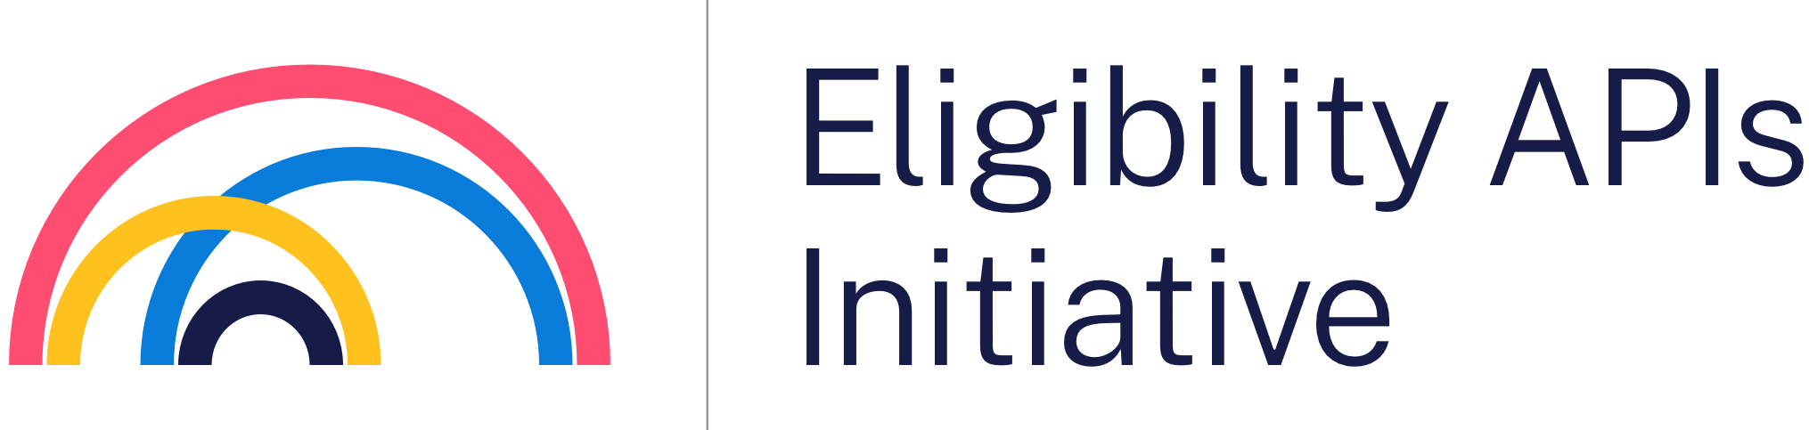
Exploring the idea of sharing eligibility criteria across multiple states via APIs to reduce the work states need to build in their own systems.
Notes:
Another example: Eligibility APIs Initiative
We’re exploring the idea of sharing eligibility criteria
across multiple states via APIs
reduce the work states need to build in their own systems.

Slide 66
Modernizing these systems is hard.
Notes:
As I said before, modernizing these systems is hard
We’ve had success using this approach, but it’s a long road
Hopefully this provides some food for thought.

Slide 67
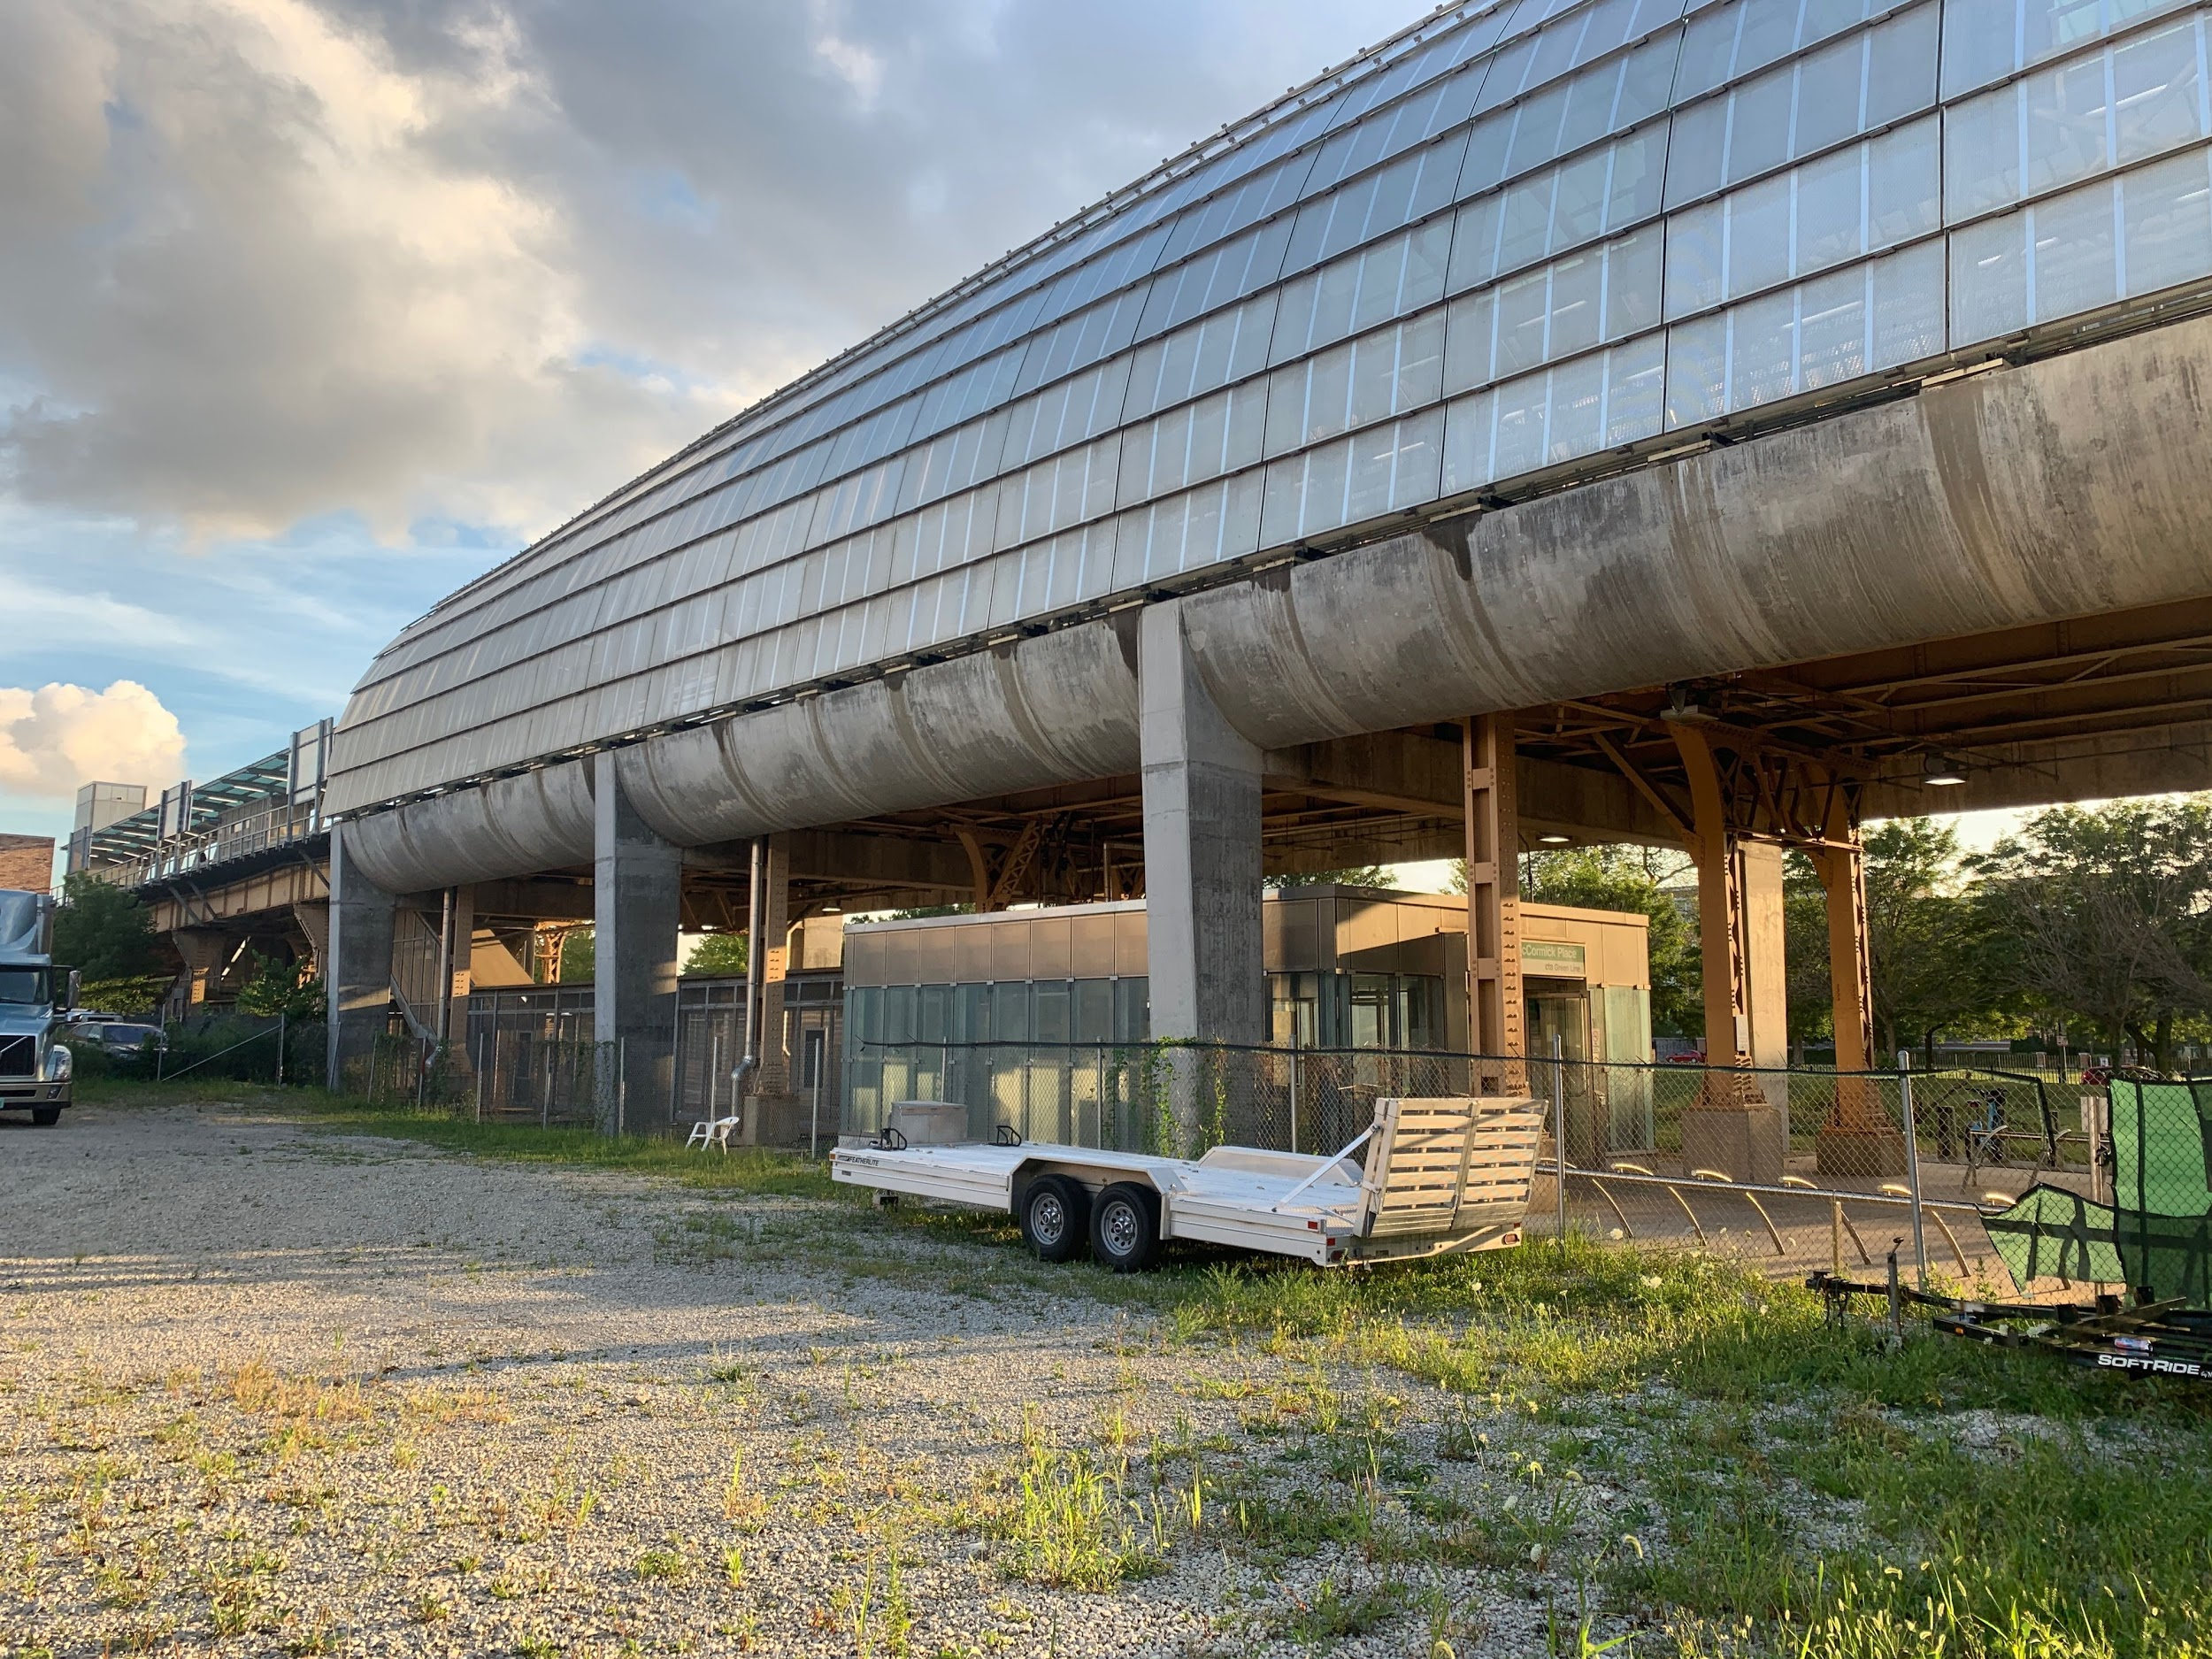
Notes:
Public transit - another complex system in need of modernization
Cermak-McCormick Place stop on the Green line
Taken a similar approach
engineered and constructed around existing structure
while maintaining full transit service

Slide 68
Notes:
They adding new structure alongside old
They maintained service
Not sure if they intend to remove the original structure
Important to state building software is not like constructing physical structures
That’s often a problematic metaphor
But they are thinking about how they can make it work
We all need to

Slide 69

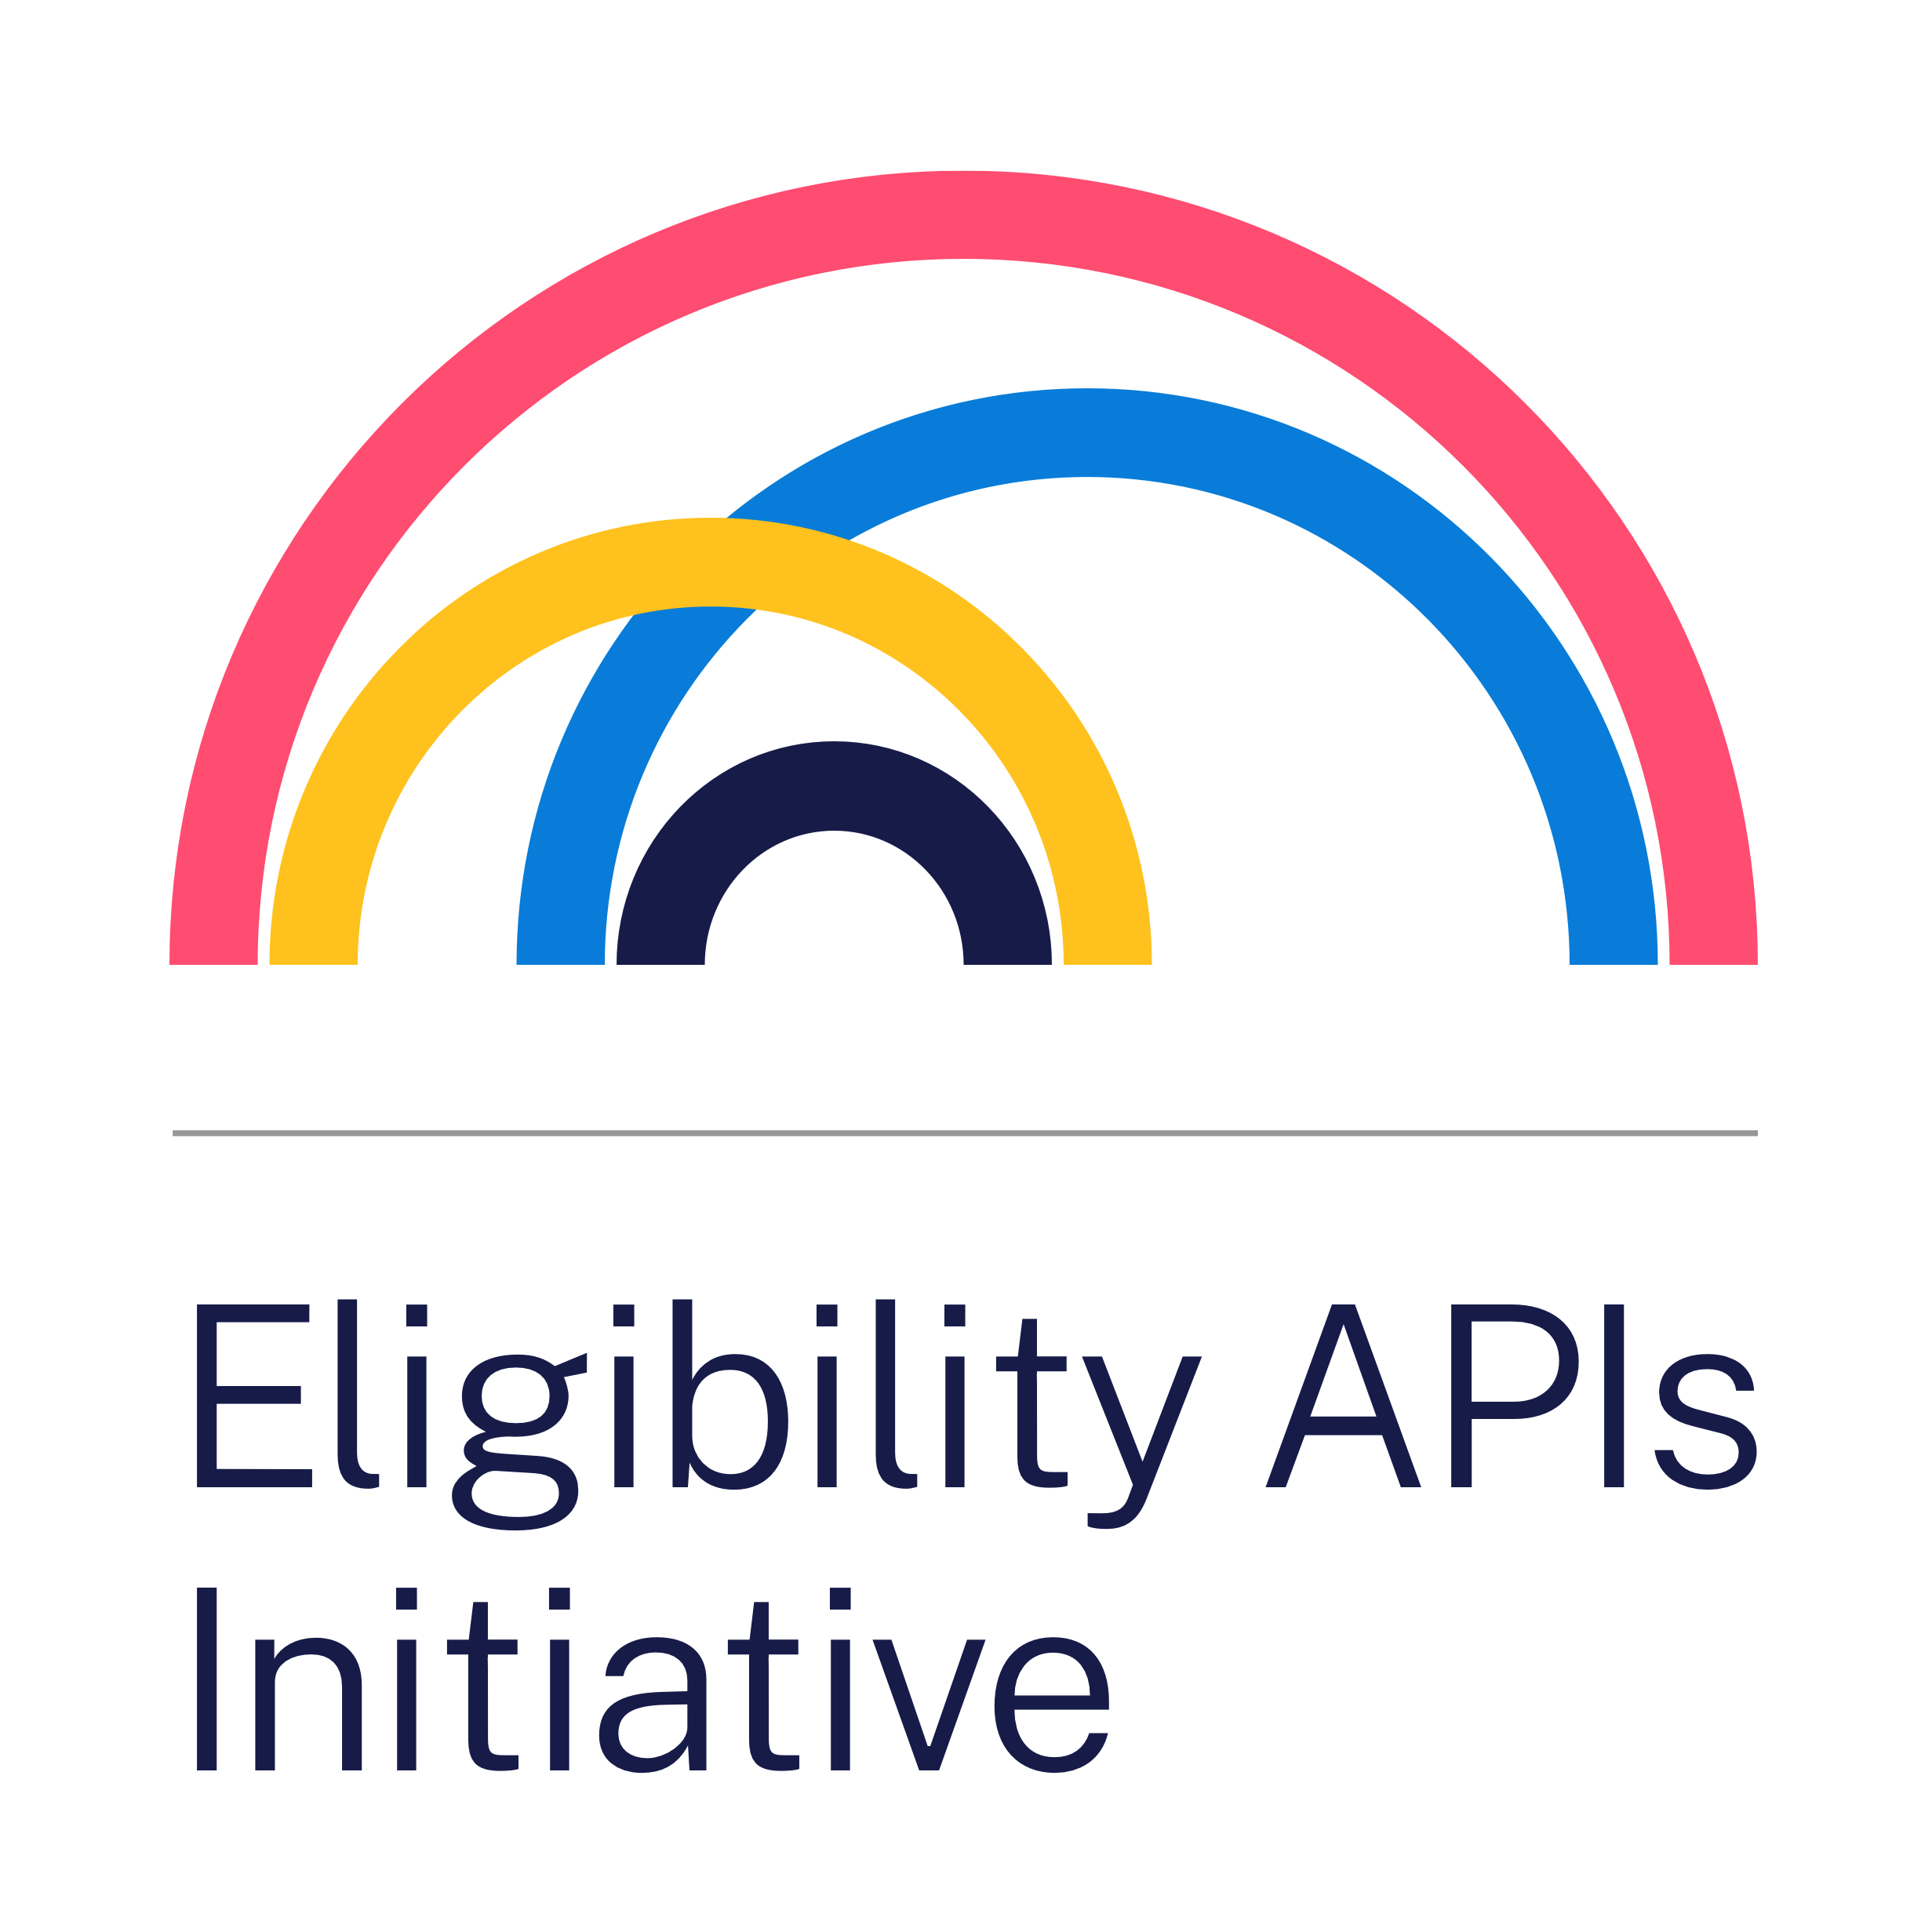
18F Human Services Portfolio
Talk to me
Talk to Robin
github.com/18F/MESC2019
Notes:
I’ll leave this up here
We’ve got a number of people to talk to
Portfolio
Me,
Robin
Link
happy to answer questions
Greg Walker here to help with some of the meatier technical questions you may have.

Slide 70
Thanks to the following colleagues whose ideas I’ve pulled from in this presentation:
Steven Reilly
Jeremy Zilar
Uchenna Moka-Solana
Dr. Robert Read

